Slide 2
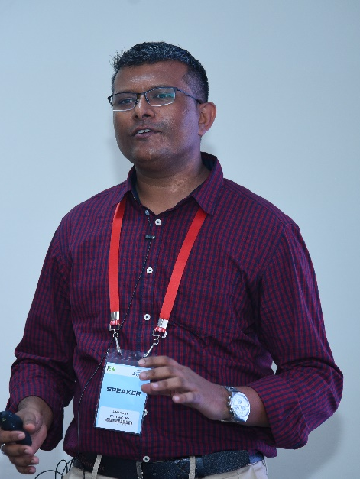
AMAR PRUSTY
Architect, DXC Technology India

Slide 3
Hybrid Multi Cloud Edge IOT Security
AMAR PRUSTY

Slide 4

Speaker Experience
Cloud & Data Center Architect
Worked for Global Clients across Industry Verticals
Been in IT 20+ years
TOGAF, ITIL, CCNA, Cloud, Storage, Virtualization, EUC
Interests - Security, DevOps, AI, IOT, Blockchain, Analytics
Hobbies– Cooking, Cycling, Reading, Travelling
https://www.linkedin.com/in/amar-prusty-07913028/
Confidential – For Training Purposes Only

Slide 5
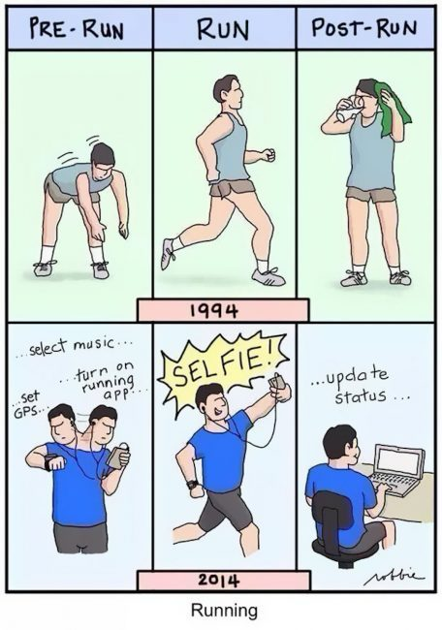
Notes:
No of end devices that are connected to internet are expected to rise above 50+ billion by 2020.
cloud computing architectures won’t be able to handle the demand of the Internet of things
So only cloud is not the optimal solution to handle this massive explosion.
Fog is needed in between to optimize – need for an interplay of cloud and fog.

Slide 6
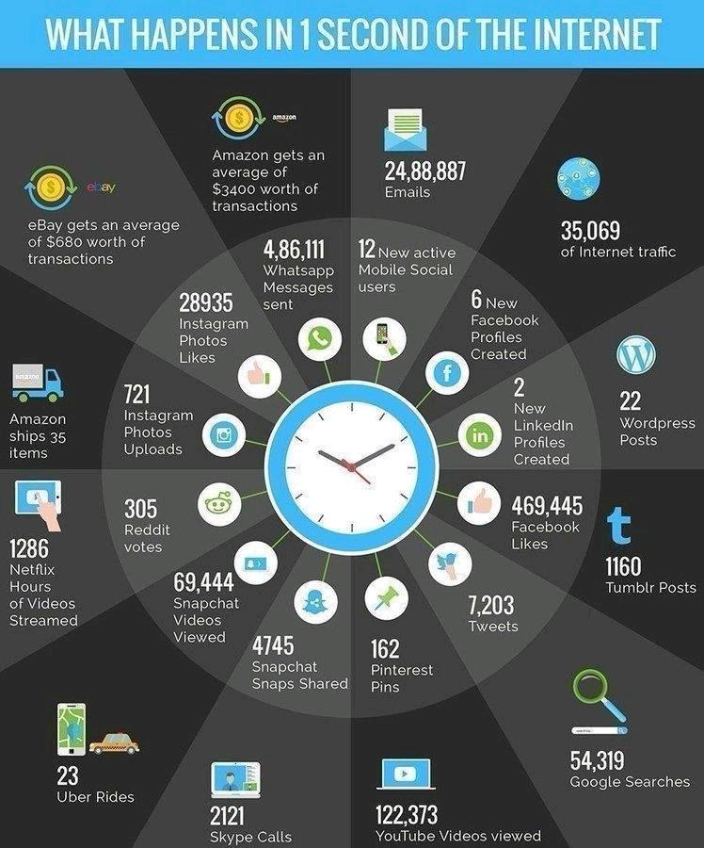
Notes:
No of end devices that are connected to internet are expected to rise above 50+ billion by 2020.
cloud computing architectures won’t be able to handle the demand of the Internet of things
So only cloud is not the optimal solution to handle this massive explosion.
Fog is needed in between to optimize – need for an interplay of cloud and fog.

Slide 7
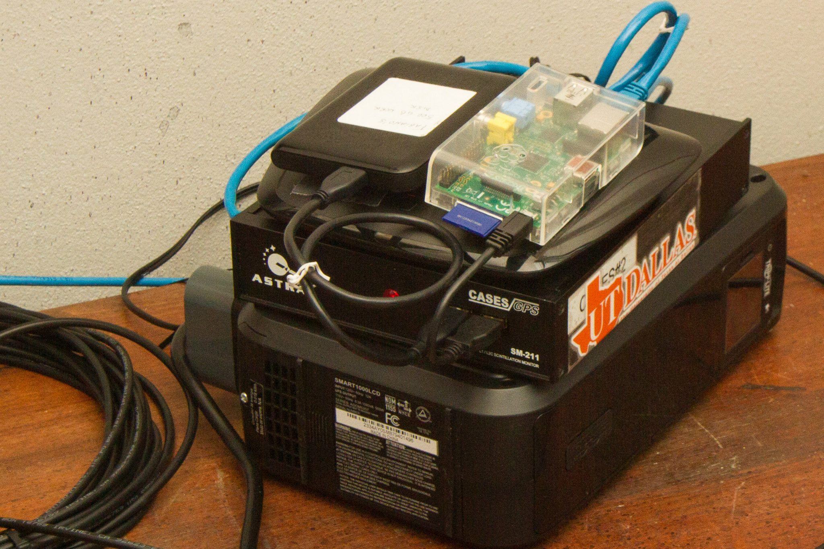
Information Security
Office of Budget and Finance
Education – Partnership – Solutions
Notes:
Just what is this?
Its components are:
A Raspberry Pi, an external hard drive, a wireless router, a GSM device, a battery backup.
What does it do, what is it for?
An IoT mystery….

Slide 8
What is IoT?
Information Security
Office of Budget and Finance
Education – Partnership – Solutions
The Internet of Things (IoT) is the network of physical objects—devices, vehicles, buildings and other items embedded with electronics, software, sensors, and network connectivity—that enables these objects to collect and exchange data.
Notes:
The Internet of Things (IoT) definition.

Slide 9
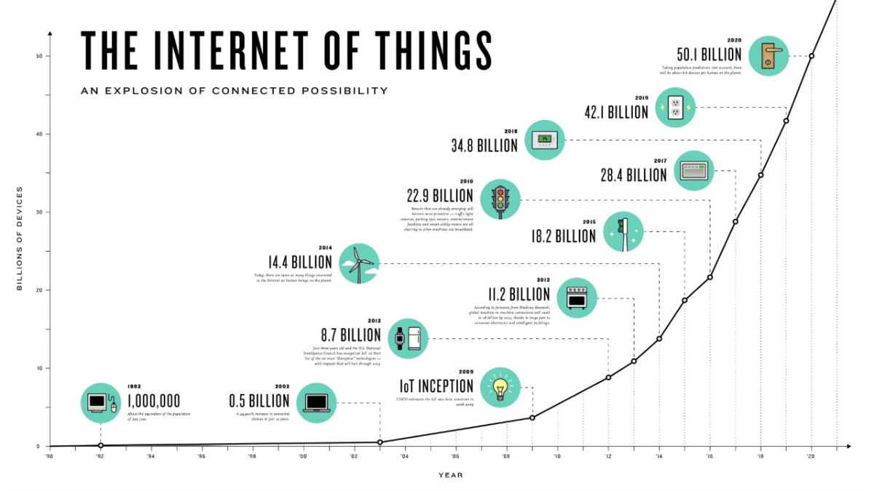
Notes:
No of end devices that are connected to internet are expected to rise above 50+ billion by 2020.
cloud computing architectures won’t be able to handle the demand of the Internet of things
So only cloud is not the optimal solution to handle this massive explosion.
Fog is needed in between to optimize – need for an interplay of cloud and fog.

Slide 10
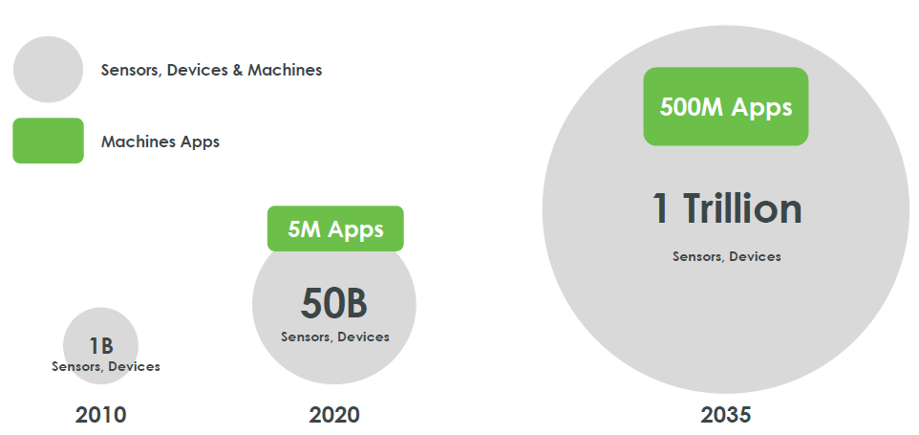
Information Security
Office of Budget and Finance
Education – Partnership – Solutions
Notes:
And is there concern about IoT, given the concepts of privacy and security in today’s digital age? We may look at how media presents technology in both positive and negative lights.

Slide 11
Various Names, One Concept
Information Security
Office of Budget and Finance
Education – Partnership – Solutions
M2M (Machine to Machine)
“Internet of Everything” (Cisco Systems)
“World Size Web” (Bruce Schneier)
“Skynet” (Terminator movie)
Notes:
British entrepreneur Kevin Ashton first coined the term in 1999 while working at Auto-ID Labs (originally called Auto-ID centers - referring to a global network of Radio-frequency identification (RFID) connected objects).[10] Typically, IoT is expected to offer advanced connectivity of devices, systems, and services that goes beyond machine-to-machine communications (M2M) and covers a variety of protocols, domains, and applications.[11] The interconnection of these embedded devices (including smart objects), is expected to usher in automation in nearly all fields, while also enabling advanced applications like a Smart Grid,[12] and expanding to the areas such as smart cities.
Cisco Systems refers to IoT as the “Internet of Everything”…
Bruce Schinerer recently referred to two new colloquial terms – World Spanning Robot and Benign Organization. There is also the term “Skynet” in reference to the Terminator movies that is frequently discussed in Blog and online postings/jargon.

Slide 12
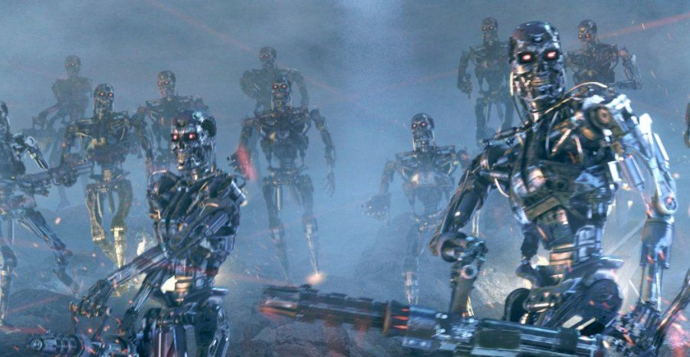
Information Security
Office of Budget and Finance
Education – Partnership – Solutions
Notes:
And is there concern about IoT, given the concepts of privacy and security in today’s digital age? We may look at how media presents technology in both positive and negative lights.

Slide 13

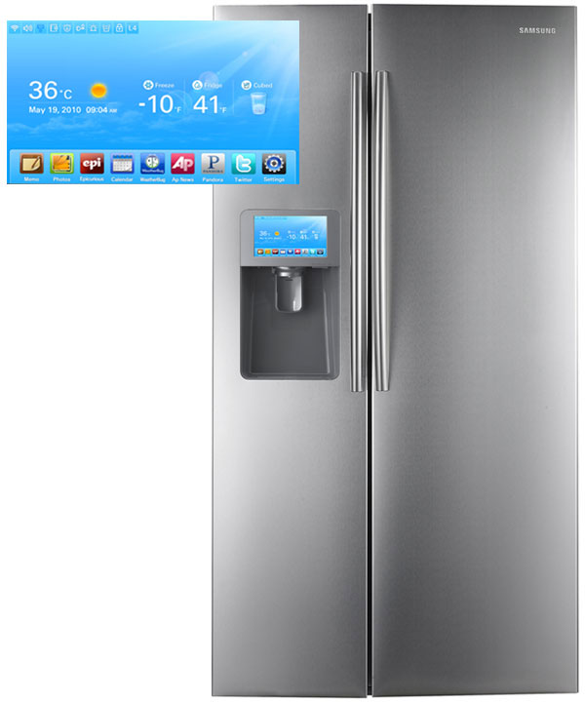
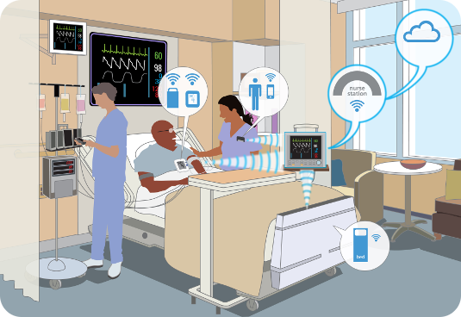
Information Security
Office of Budget and Finance
Education – Partnership – Solutions
Smart Appliances
Wearable Tech
Healthcare
Notes:
In our daily lives, we have become more reliant on IoT with our wearable tech, appliances, our cars, how we receive health care.

Slide 14
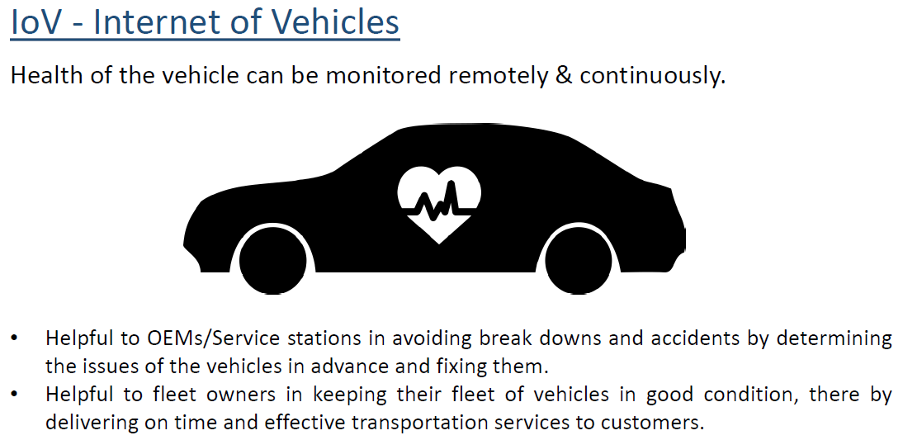
Information Security
Office of Budget and Finance
Education – Partnership – Solutions
Notes:
And is there concern about IoT, given the concepts of privacy and security in today’s digital age? We may look at how media presents technology in both positive and negative lights.

Slide 15
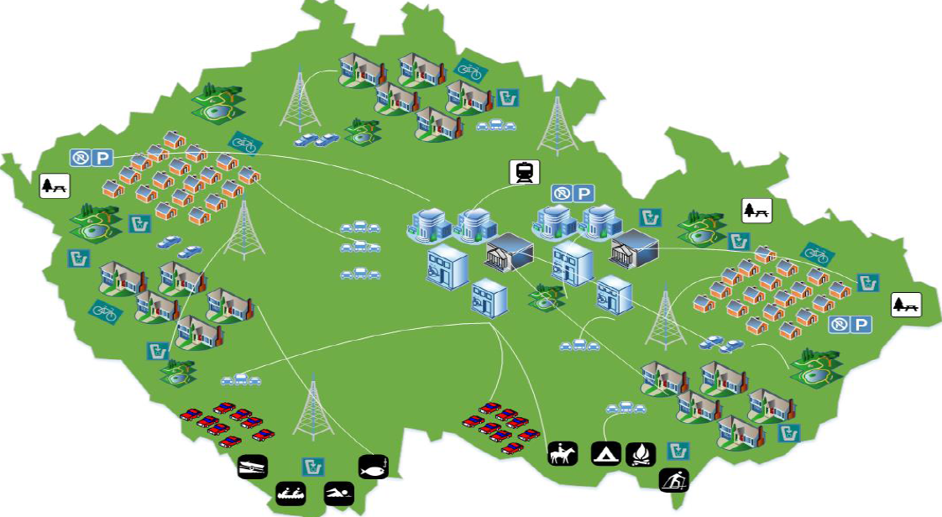
Information Security
Office of Budget and Finance
Education – Partnership – Solutions
Notes:
And is there concern about IoT, given the concepts of privacy and security in today’s digital age? We may look at how media presents technology in both positive and negative lights.

Slide 16
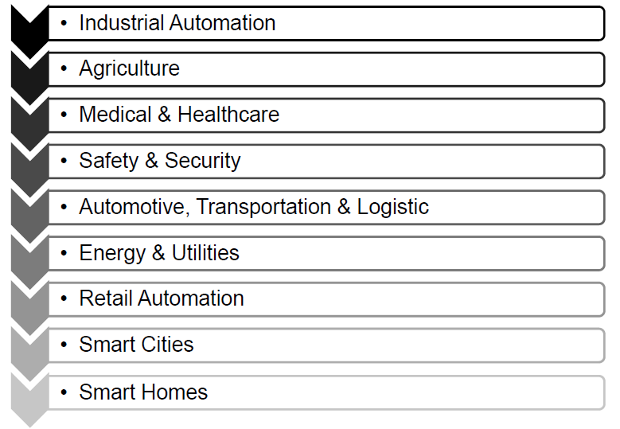
Information Security
Office of Budget and Finance
Education – Partnership – Solutions
Notes:
And is there concern about IoT, given the concepts of privacy and security in today’s digital age? We may look at how media presents technology in both positive and negative lights.

Slide 17
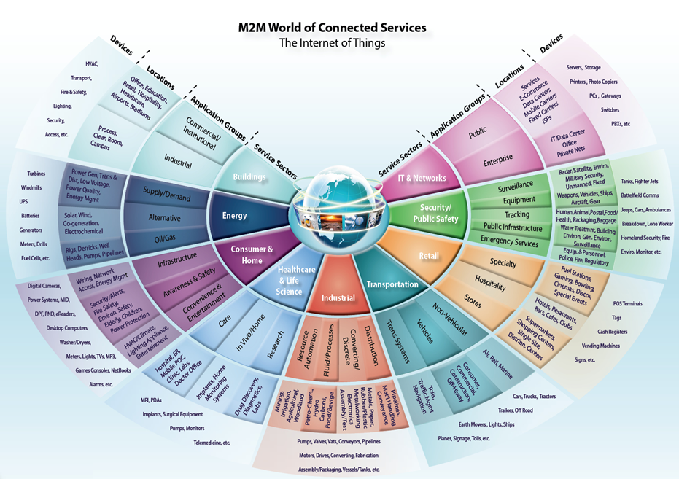
Information Security
Office of Budget and Finance
Education – Partnership – Solutions
Notes:
M2M/IoT Sector Map :: Beecham Research
http://www.beechamresearch.com/article.aspx?id=4
The following graphic from Beecham Research depicts how the Internet of Things may interact with various service sectors within the public/private sectors and ordinary consumers. Public sector entities (such as universities) may have some level of involvement and interaction within all service sectors depicted; ranging from the operation and industry elements of buildings, to levels of research, retail entities, transportation, and IT/Networks. **Place emphasis on service sectors, that it is likely that at least one example of devices may be found within university networks.

Slide 18




IoT Beyond the Hype
Municipal IoT
Smart cities
Smart grid
Industrial IoT
Connected factories
Agriculture
Logistics
Medical IoT
Smart hospitals
Electronic medical records

Slide 19
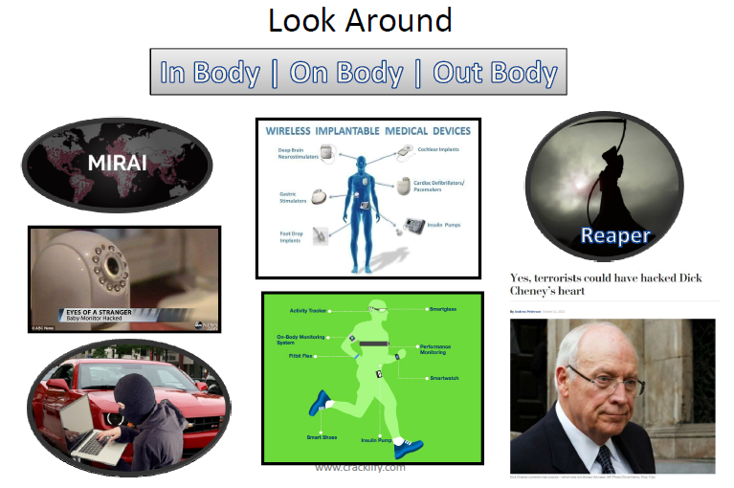
Information Security
Office of Budget and Finance
Education – Partnership – Solutions
Notes:
And is there concern about IoT, given the concepts of privacy and security in today’s digital age? We may look at how media presents technology in both positive and negative lights.

Slide 20
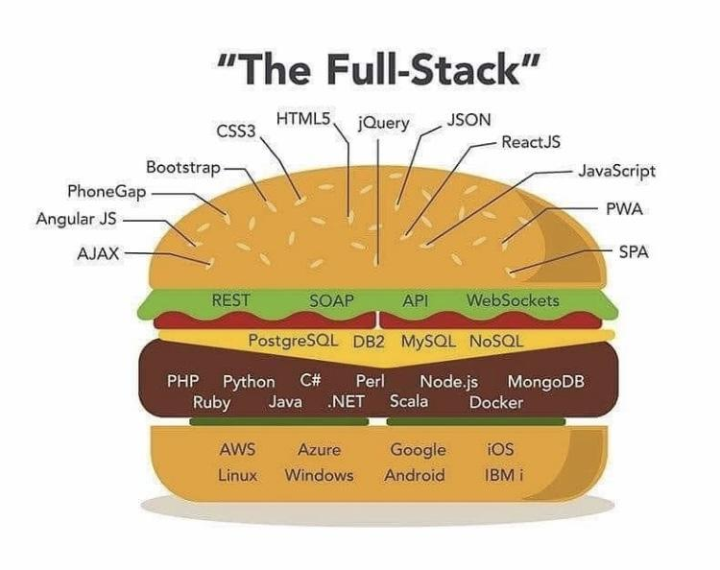
Notes:
No of end devices that are connected to internet are expected to rise above 50+ billion by 2020.
cloud computing architectures won’t be able to handle the demand of the Internet of things
So only cloud is not the optimal solution to handle this massive explosion.
Fog is needed in between to optimize – need for an interplay of cloud and fog.

Slide 21
The Challenge of IoT Security
IoT is an evolutionary technology
IoT
Cloud
Mobile
Web
Network
Operating System
Hardware

Slide 22
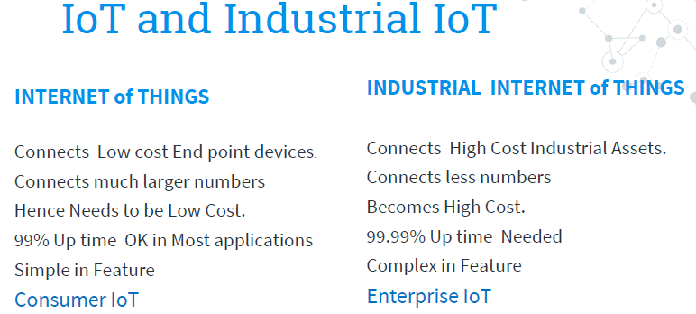
Notes:
No of end devices that are connected to internet are expected to rise above 50+ billion by 2020.
cloud computing architectures won’t be able to handle the demand of the Internet of things
So only cloud is not the optimal solution to handle this massive explosion.
Fog is needed in between to optimize – need for an interplay of cloud and fog.

Slide 23
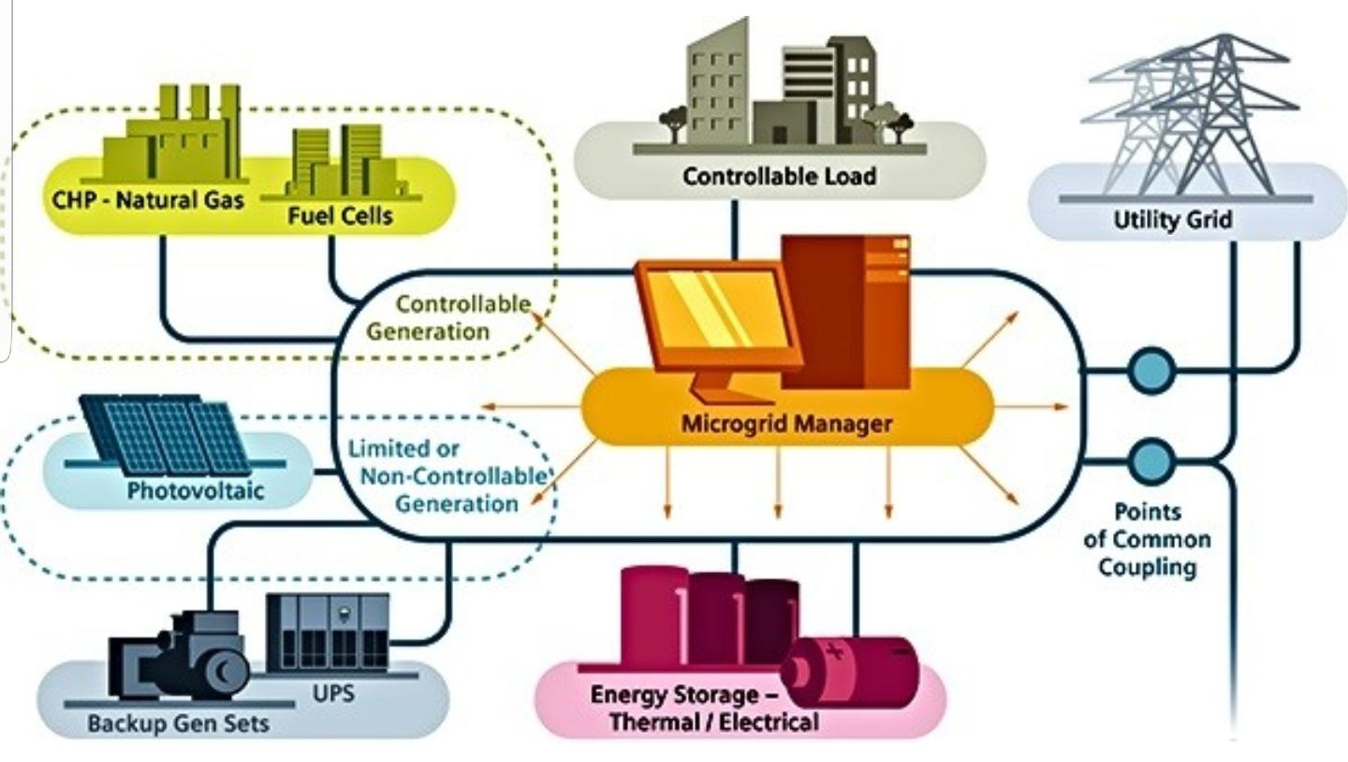
Information Security
Office of Budget and Finance
Education – Partnership – Solutions
Notes:
And is there concern about IoT, given the concepts of privacy and security in today’s digital age? We may look at how media presents technology in both positive and negative lights.

Slide 24
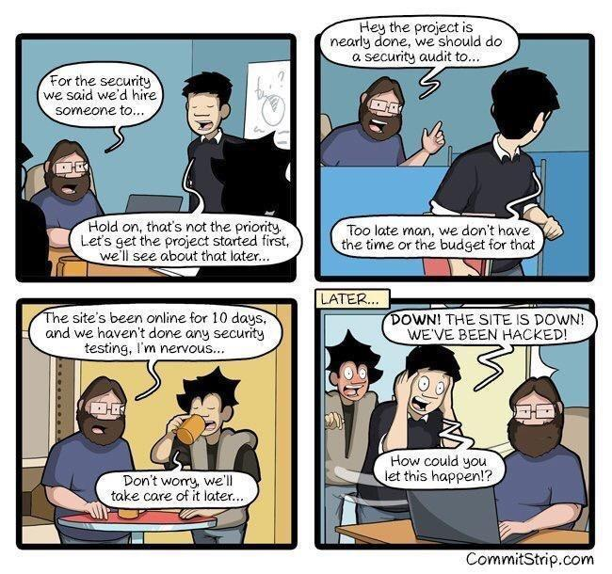
Notes:
No of end devices that are connected to internet are expected to rise above 50+ billion by 2020.
cloud computing architectures won’t be able to handle the demand of the Internet of things
So only cloud is not the optimal solution to handle this massive explosion.
Fog is needed in between to optimize – need for an interplay of cloud and fog.

Slide 25
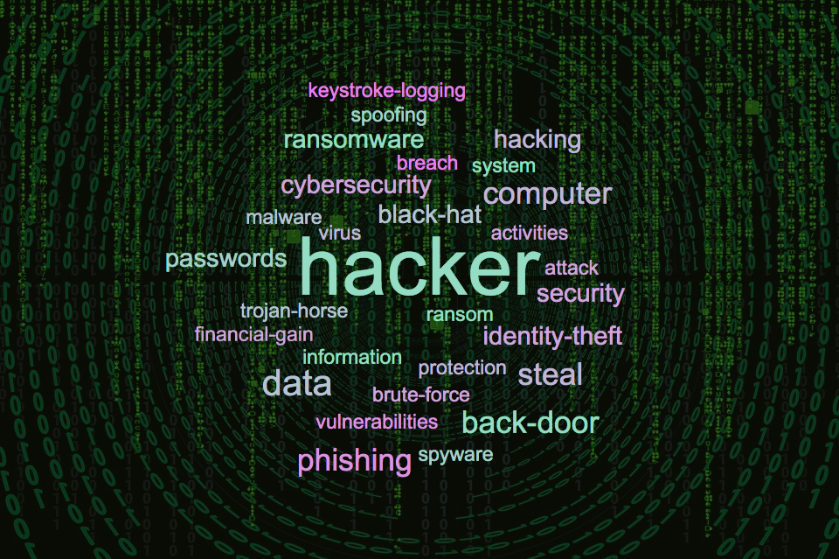
Notes:
No of end devices that are connected to internet are expected to rise above 50+ billion by 2020.
cloud computing architectures won’t be able to handle the demand of the Internet of things
So only cloud is not the optimal solution to handle this massive explosion.
Fog is needed in between to optimize – need for an interplay of cloud and fog.

Slide 26

Notes:
No of end devices that are connected to internet are expected to rise above 50+ billion by 2020.
cloud computing architectures won’t be able to handle the demand of the Internet of things
So only cloud is not the optimal solution to handle this massive explosion.
Fog is needed in between to optimize – need for an interplay of cloud and fog.

Slide 27
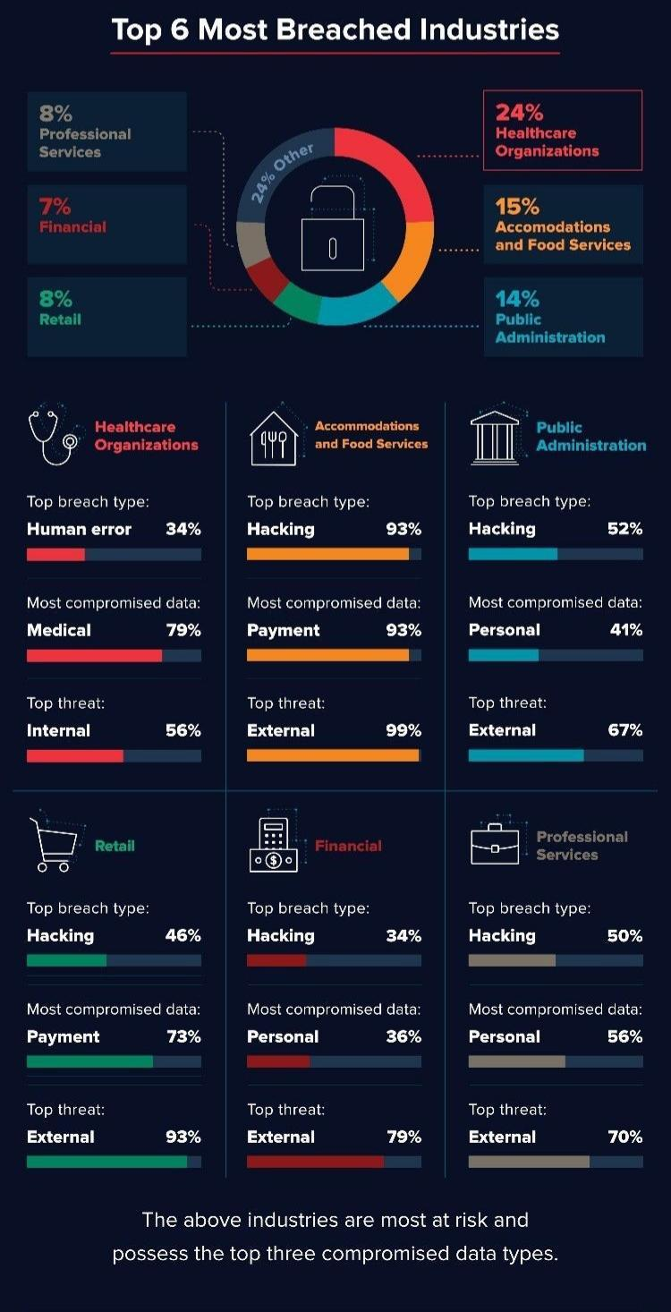
Notes:
No of end devices that are connected to internet are expected to rise above 50+ billion by 2020.
cloud computing architectures won’t be able to handle the demand of the Internet of things
So only cloud is not the optimal solution to handle this massive explosion.
Fog is needed in between to optimize – need for an interplay of cloud and fog.

Slide 28
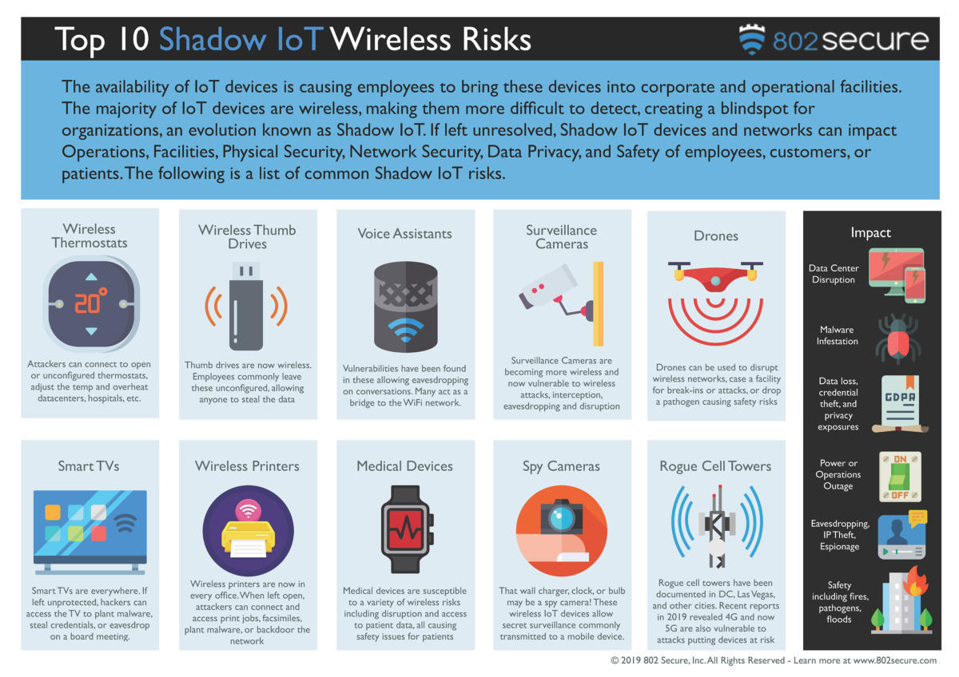
Notes:
No of end devices that are connected to internet are expected to rise above 50+ billion by 2020.
cloud computing architectures won’t be able to handle the demand of the Internet of things
So only cloud is not the optimal solution to handle this massive explosion.
Fog is needed in between to optimize – need for an interplay of cloud and fog.

Slide 29
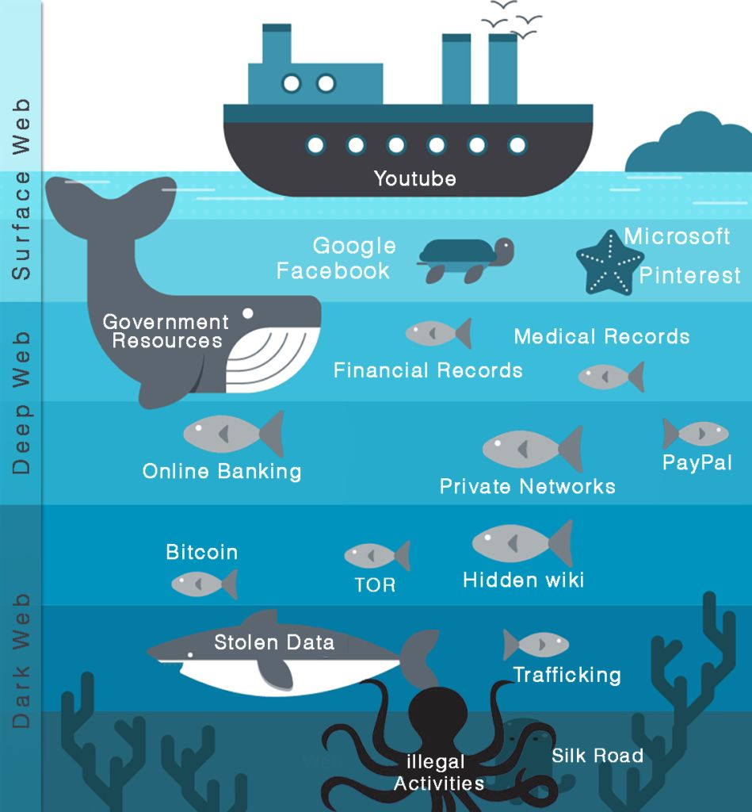
Notes:
No of end devices that are connected to internet are expected to rise above 50+ billion by 2020.
cloud computing architectures won’t be able to handle the demand of the Internet of things
So only cloud is not the optimal solution to handle this massive explosion.
Fog is needed in between to optimize – need for an interplay of cloud and fog.

Slide 30
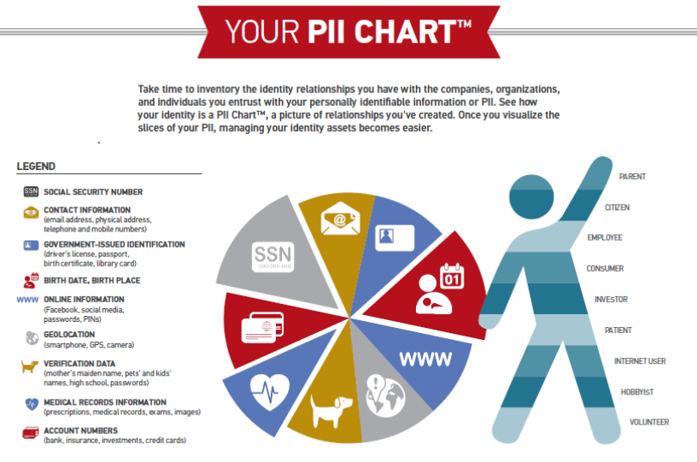
Information Security
Office of Budget and Finance
Education – Partnership – Solutions
Notes:
And is there concern about IoT, given the concepts of privacy and security in today’s digital age? We may look at how media presents technology in both positive and negative lights.

Slide 31
Data Types and Compliance
Data, being the key attribute of an information technology system, is the driving force in selecting the appropriate level of security.
Develop detail data flows
If security controls and approach is not matched to the characterization of data then:
The system will be more costly and utility reduced if over secured.
The system and data will be vulnerable and could lead to a breach.

Slide 32
Risk = (Data Type + Breach Probability)/Data Security Profile
Risk Profile
Risk= (Data Type * Breach Probability)/Security Profile
Data Pedigree
Data Security Profile + Data Owner + Originating System + Data Integrity Confidence
NIST SP 800-53v4
SP 800-53v4, Pub 1075, CJIS-SP
Security
Policies & Procedures Profile 1
Policies & Procedures Profile 2
Policies & Procedures Profile 3
Policies & Procedures Profile 4
Data Security Profile 1
Data Security Profile 2
Data Security Profile 3
Data Security Profile 4
Integrity Controls
Privacy Act FISMA
HIPAA PCI-DSS FERPA
Pub 1075 CJIS
Public Data
Classification: Low
Classification: Moderate
Classification: High
Data Object
Public Data
Confidential Data
Restricted Data
Public Data
Sensitive Data

Slide 33
Data Classification Comparison:
Project - Federal Agency – National Security
Direct comparison is difficult because data classification is specific to mission, context, aggregation and system.
Detailed review of data sets, usage and regulatory compliance yields appropriate classifications.
Data can transition up or down in classification levels based on certain factors.
National Security/Dept.
of Defense Classifications
Data Classifications
Federal Agency Classifications
Grave Damage
Classification: Top Secret
Pub 1075 CJIS
Moderate +
CFR Title 28, DOJ-BoPrisons
Severe Adverse Effect
Classification: High
Serious Damage
Classification: Secret
HIPAA PCI-DSS FERPA
Classification: Moderate
HIPAA PCI-DSS FERPA, Pub 1075
Serious Adverse Effect
Classification: Moderate
Damage
Classification: Confidential
Privacy Act FISMA
Classification: Low
Privacy Act FISMA
Limited Adverse Effect
Classification: Low
Limited Damage
Classification: For Official Use Only (FOUO)
DoDM 5200, E.O. 13256
Integrity Controls
Classification: Public
Integrity Controls
No Adverse Effect
Classification:
Public
No Damage
Classification: Unclassified
Regulations, NIST SP 800-53v4, FIPS, PUB 1075, Agency Specific Guidance

Slide 34
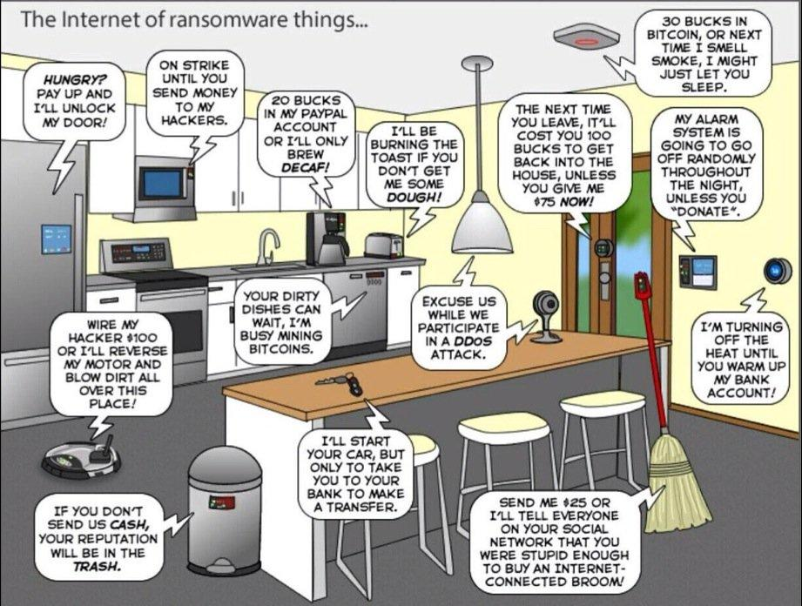
Notes:
No of end devices that are connected to internet are expected to rise above 50+ billion by 2020.
cloud computing architectures won’t be able to handle the demand of the Internet of things
So only cloud is not the optimal solution to handle this massive explosion.
Fog is needed in between to optimize – need for an interplay of cloud and fog.

Slide 35
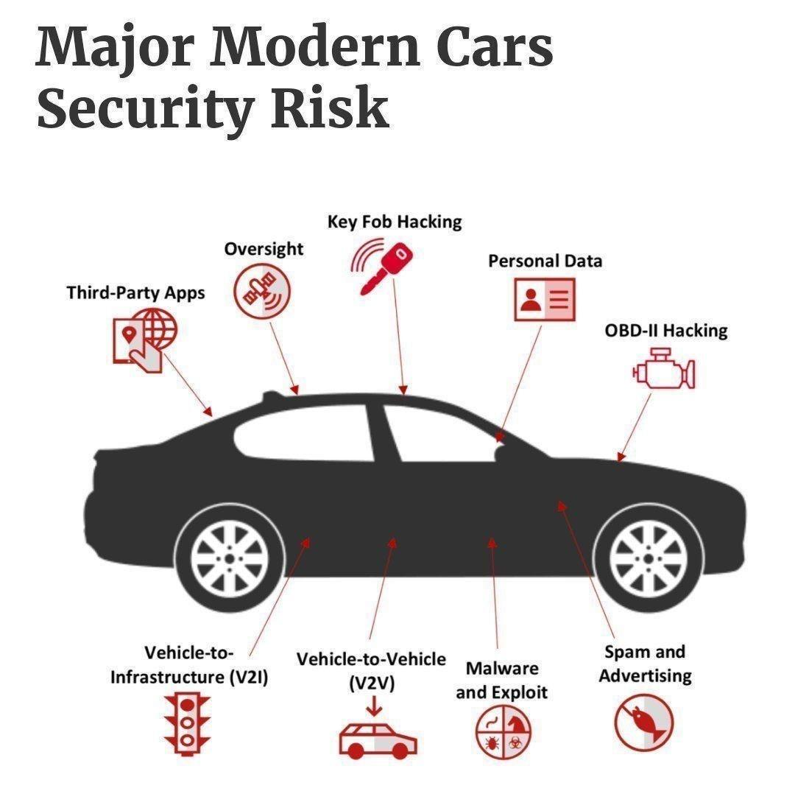
Information Security
Office of Budget and Finance
Education – Partnership – Solutions
Notes:
And is there concern about IoT, given the concepts of privacy and security in today’s digital age? We may look at how media presents technology in both positive and negative lights.

Slide 36
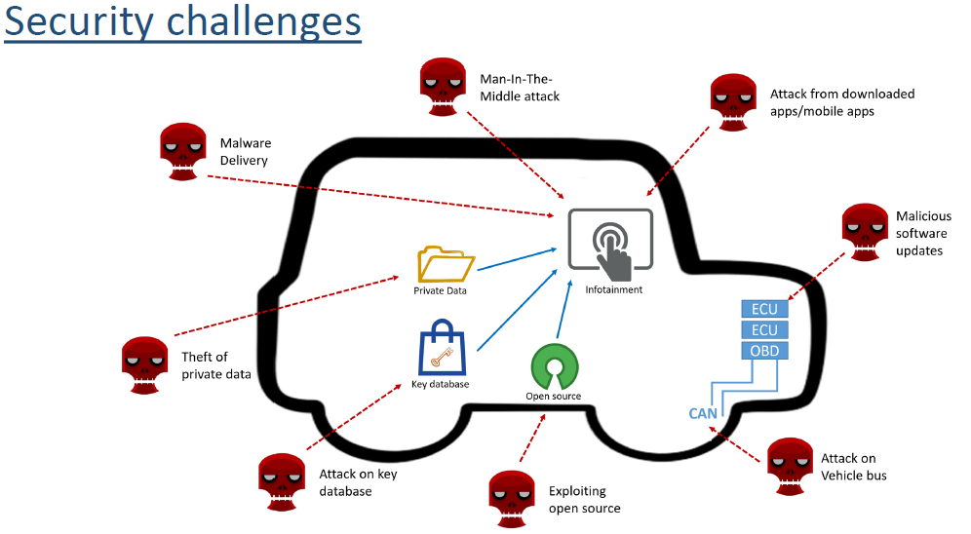
Information Security
Office of Budget and Finance
Education – Partnership – Solutions
Notes:
And is there concern about IoT, given the concepts of privacy and security in today’s digital age? We may look at how media presents technology in both positive and negative lights.

Slide 37
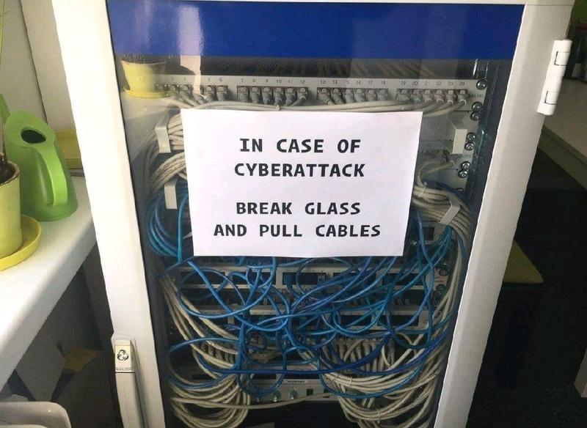
Notes:
No of end devices that are connected to internet are expected to rise above 50+ billion by 2020.
cloud computing architectures won’t be able to handle the demand of the Internet of things
So only cloud is not the optimal solution to handle this massive explosion.
Fog is needed in between to optimize – need for an interplay of cloud and fog.

Slide 38
Security Threats
Malicious Code
Ransomware
Virus
Worms
Trojans
Logic bombs
Malware
Botnet
Malicious Code Countermeasures
Scanners
IDS/IPS
Security testing
Anti-malware
Code signing
Sandboxing
Appropriate patching

Slide 39
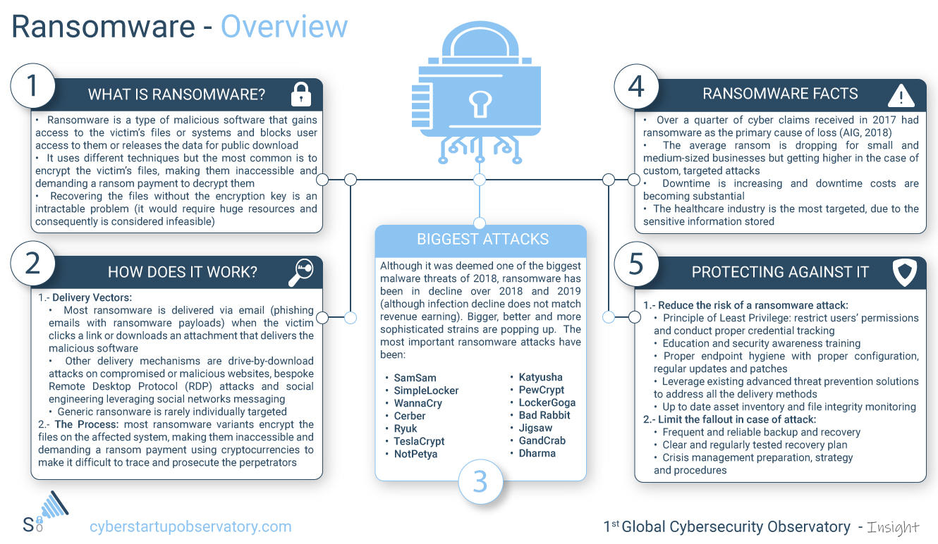
Notes:
No of end devices that are connected to internet are expected to rise above 50+ billion by 2020.
cloud computing architectures won’t be able to handle the demand of the Internet of things
So only cloud is not the optimal solution to handle this massive explosion.
Fog is needed in between to optimize – need for an interplay of cloud and fog.

Slide 40
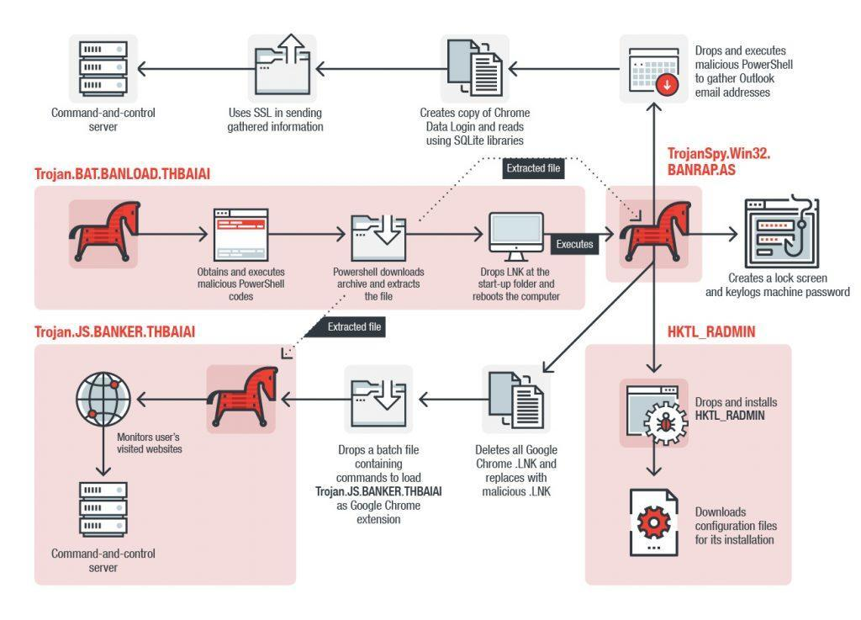
Notes:
No of end devices that are connected to internet are expected to rise above 50+ billion by 2020.
cloud computing architectures won’t be able to handle the demand of the Internet of things
So only cloud is not the optimal solution to handle this massive explosion.
Fog is needed in between to optimize – need for an interplay of cloud and fog.

Slide 41
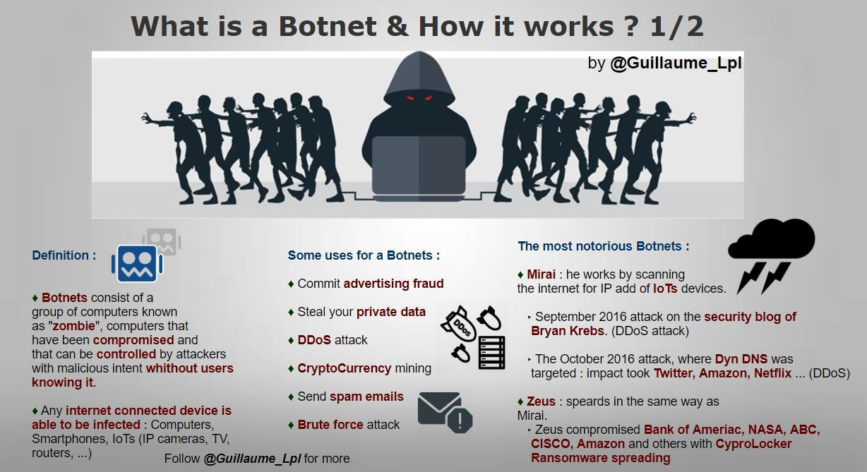
Notes:
No of end devices that are connected to internet are expected to rise above 50+ billion by 2020.
cloud computing architectures won’t be able to handle the demand of the Internet of things
So only cloud is not the optimal solution to handle this massive explosion.
Fog is needed in between to optimize – need for an interplay of cloud and fog.

Slide 42
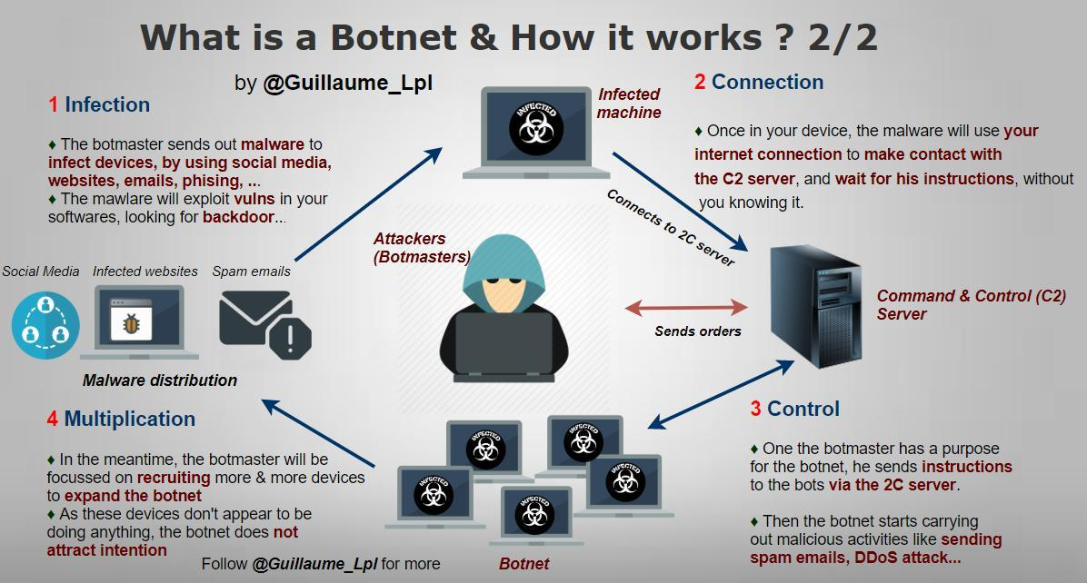
Notes:
No of end devices that are connected to internet are expected to rise above 50+ billion by 2020.
cloud computing architectures won’t be able to handle the demand of the Internet of things
So only cloud is not the optimal solution to handle this massive explosion.
Fog is needed in between to optimize – need for an interplay of cloud and fog.

Slide 43
Security Threats
Malicious Activity
Social Engineering
Spoofing
Phishing
Spam
Botnets
Malicious Activity Countermeasures
User Awareness Training
System Hardening
Patching
Sandboxing
Policies and Procedures

Slide 44
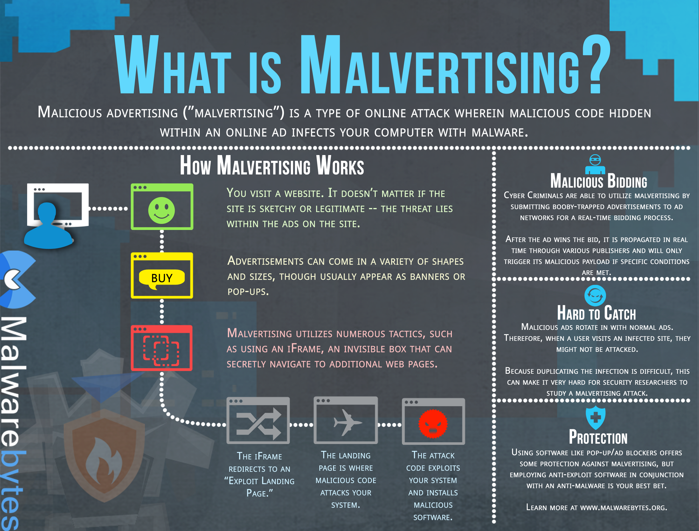
Notes:
No of end devices that are connected to internet are expected to rise above 50+ billion by 2020.
cloud computing architectures won’t be able to handle the demand of the Internet of things
So only cloud is not the optimal solution to handle this massive explosion.
Fog is needed in between to optimize – need for an interplay of cloud and fog.

Slide 45
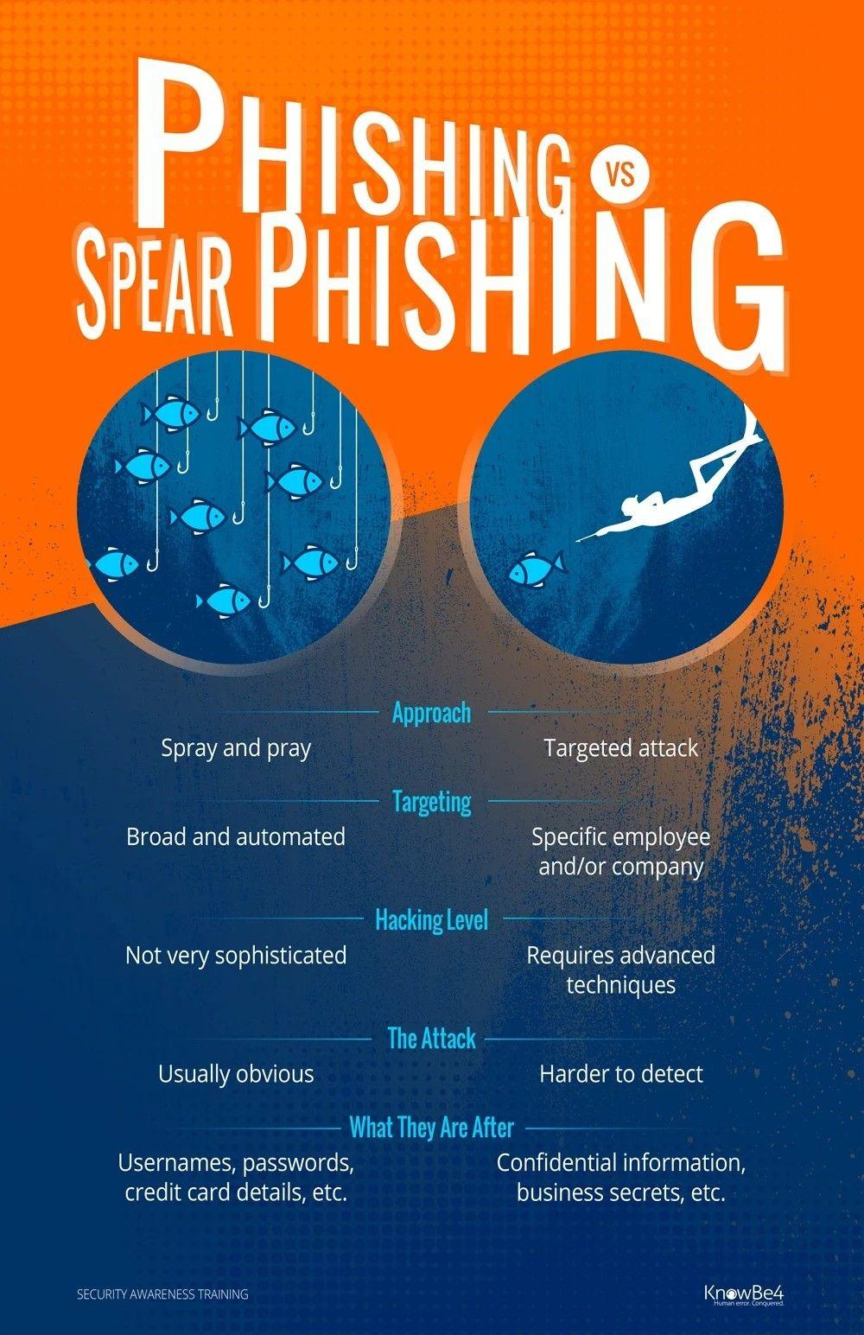
Notes:
No of end devices that are connected to internet are expected to rise above 50+ billion by 2020.
cloud computing architectures won’t be able to handle the demand of the Internet of things
So only cloud is not the optimal solution to handle this massive explosion.
Fog is needed in between to optimize – need for an interplay of cloud and fog.

Slide 46
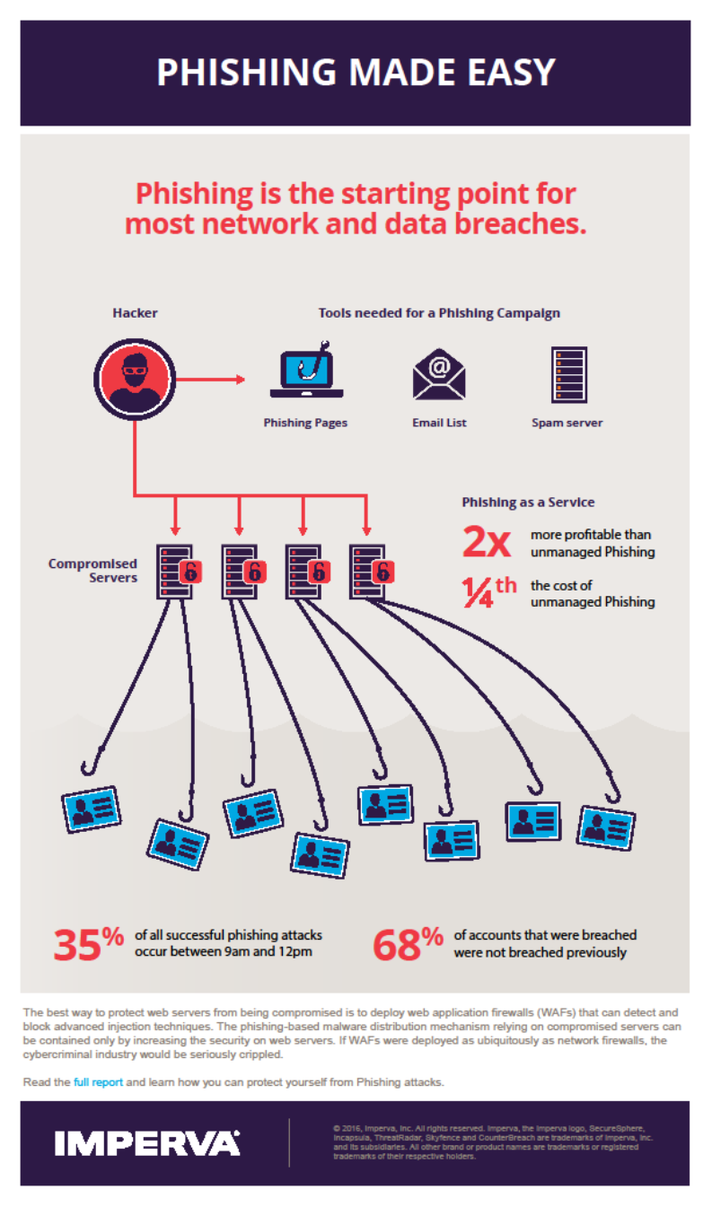
Notes:
No of end devices that are connected to internet are expected to rise above 50+ billion by 2020.
cloud computing architectures won’t be able to handle the demand of the Internet of things
So only cloud is not the optimal solution to handle this massive explosion.
Fog is needed in between to optimize – need for an interplay of cloud and fog.

Slide 47
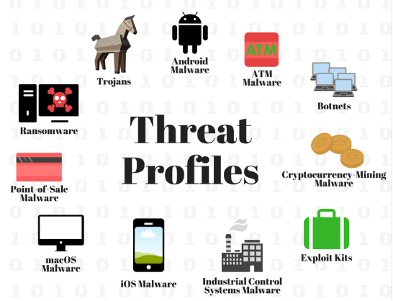
Notes:
No of end devices that are connected to internet are expected to rise above 50+ billion by 2020.
cloud computing architectures won’t be able to handle the demand of the Internet of things
So only cloud is not the optimal solution to handle this massive explosion.
Fog is needed in between to optimize – need for an interplay of cloud and fog.

Slide 48
Security Threats
Abuse and Nefarious use
Hackers continue to leverage technologies to improve their reach, avoid detection, and improve the effectiveness of their activities.
Cloud providers are actively being targeted, partially because their relatively weak registration systems facilitate anonymity, and providers’ fraud detection capabilities are limited.
Countermeasures: Patching, intrusion detection, security awareness training, background checks

Slide 49
Security Threats
Insecure interfaces and APIs
Cloud providers strive to provide security and that it is integrated into their service models.
Consumers of services need to understand the security implications associated with the usage, management, orchestration and monitoring of cloud services.
Reliance on a weak set of interfaces and APIs exposes organizations to a variety of security issues related to confidentiality, integrity, availability and accountability.
Countermeasures: Architecture review, security testing, patching schedules, Service Level Agreements, legal agreements (BAA)

Slide 50
Security Threats
Malicious insiders
The impact that malicious insiders can have on an organization is great because of their level of access and understanding of data and information technology assets.
Theft, reputation damage and loss of productivity are some examples of how malicious insider can affect an operation.
Organizations that adopt cloud services need to understand the human element and that the responsibility for a malicious insider is relevant for staff of the cloud provider.
Countermeasures: Background checks, policies and procedures, non-repudiation, two man work, security awareness training, least privilege

Slide 51
Security Threats
Shared technology issues
Attacks have surfaced in recent years that target the shared technology inside cloud computing environments.
As a result, attackers focus on how to impact the operations of other cloud customers, and how to gain unauthorized access to data.
Countermeasures: Patching, security testing, monitoring, security awareness training

Slide 52
Security Threats
Data loss or leakage
Data loss or leakage can have a devastating impact on a business and its impact is directly relevant to the type of data.
Compliance violations, legal ramifications
Loss of core intellectual property could have competitive and financial implications.
Countermeasures: Data Loss Prevention Applications, encryption, security awareness training, data classification, policies and procedures, least privilege

Slide 53
Security Threats
Account or service hijacking
Account and service hijacking, usually with stolen credentials, remains a top threat. With stolen credentials, attackers can often access critical cloud services, allowing them to compromise the confidentiality, integrity and availability of the services and the data.
Countermeasures: Policies and procedures, security awareness training, enforced password life, complexity and reuse

Slide 54
Security Threats
Unknown Risk Profile
When adopting a cloud service, the features and functionality may be well advertised, but one must understand the cloud service security posture/risk profile.
Understand the controls or compliance alignment
Make sure you agree with the cloud providers internal security procedures, configuration hardening, patching, auditing, and logging
Do they go through SSAE16 SOC2 audits or are FEDRamp certified?
Under what conditions can you have access to or be given an extract of logs?
Can you conduct vulnerability scanning or penetration testing on “your” infrastructure; and/or will you receive the regular reports of the results of their scanning and testing.
Countermeasures: Research, agreements, and governance

Slide 55
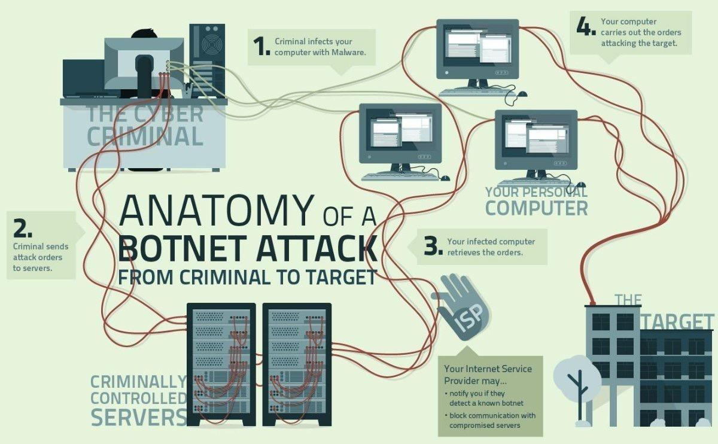
Notes:
No of end devices that are connected to internet are expected to rise above 50+ billion by 2020.
cloud computing architectures won’t be able to handle the demand of the Internet of things
So only cloud is not the optimal solution to handle this massive explosion.
Fog is needed in between to optimize – need for an interplay of cloud and fog.

Slide 56
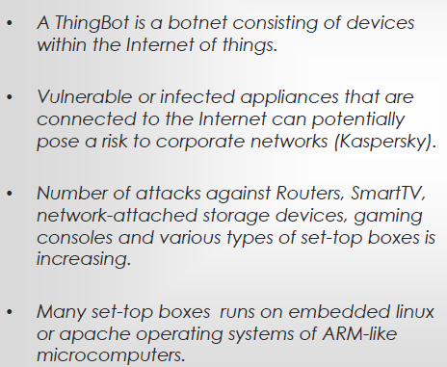
Information Security
Office of Budget and Finance
Education – Partnership – Solutions
Notes:
And is there concern about IoT, given the concepts of privacy and security in today’s digital age? We may look at how media presents technology in both positive and negative lights.

Slide 57
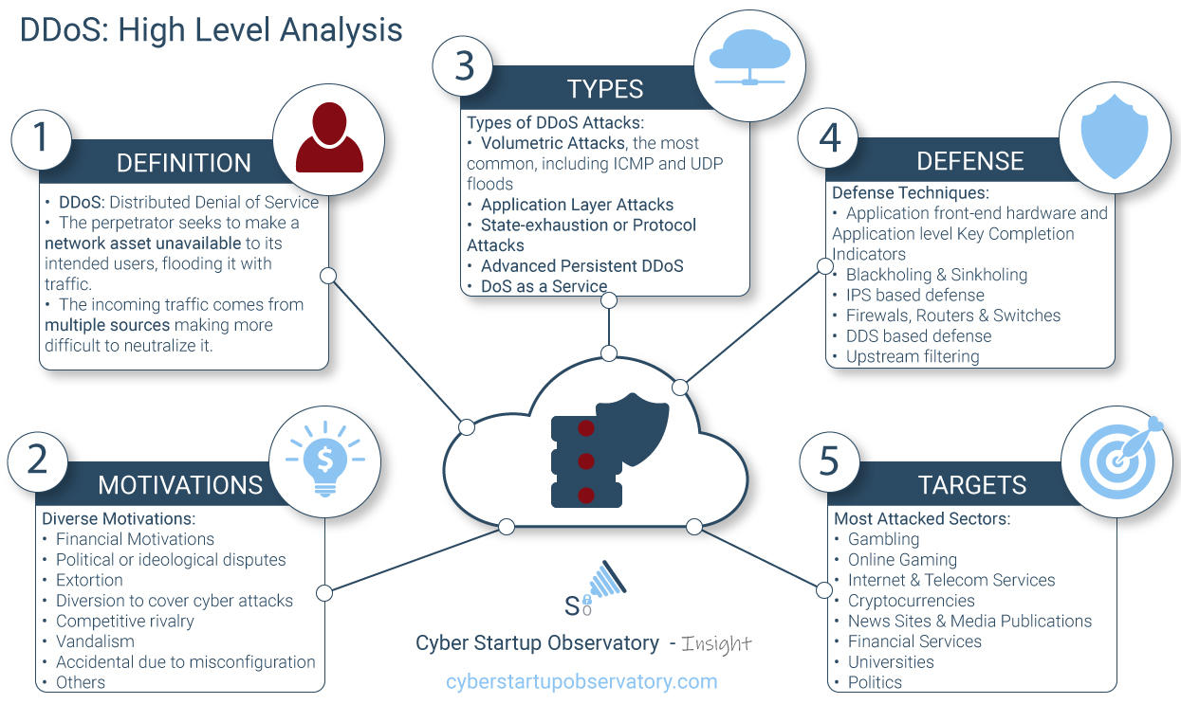
Notes:
No of end devices that are connected to internet are expected to rise above 50+ billion by 2020.
cloud computing architectures won’t be able to handle the demand of the Internet of things
So only cloud is not the optimal solution to handle this massive explosion.
Fog is needed in between to optimize – need for an interplay of cloud and fog.

Slide 58
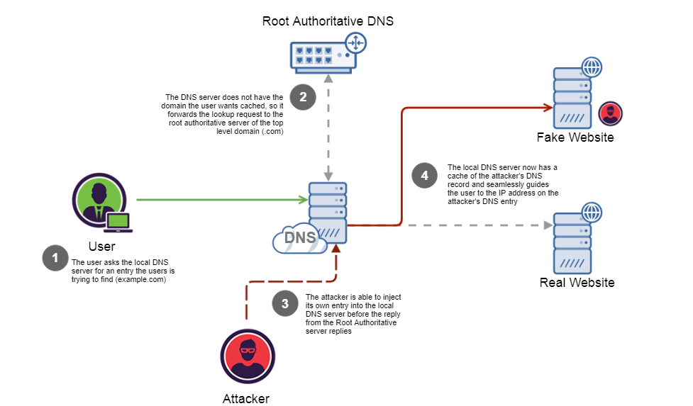
Notes:
No of end devices that are connected to internet are expected to rise above 50+ billion by 2020.
cloud computing architectures won’t be able to handle the demand of the Internet of things
So only cloud is not the optimal solution to handle this massive explosion.
Fog is needed in between to optimize – need for an interplay of cloud and fog.

Slide 59
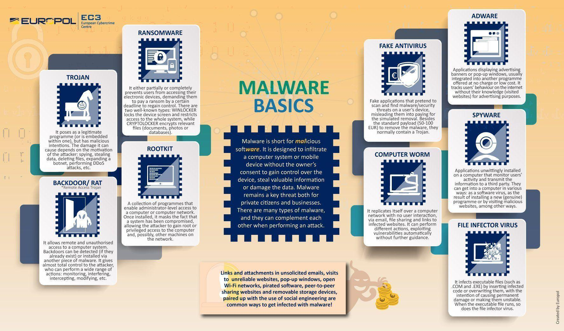
Notes:
No of end devices that are connected to internet are expected to rise above 50+ billion by 2020.
cloud computing architectures won’t be able to handle the demand of the Internet of things
So only cloud is not the optimal solution to handle this massive explosion.
Fog is needed in between to optimize – need for an interplay of cloud and fog.

Slide 60
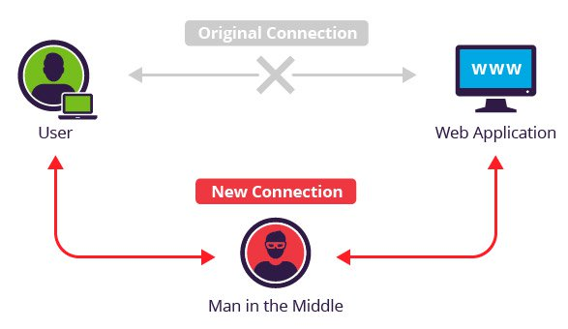
Notes:
No of end devices that are connected to internet are expected to rise above 50+ billion by 2020.
cloud computing architectures won’t be able to handle the demand of the Internet of things
So only cloud is not the optimal solution to handle this massive explosion.
Fog is needed in between to optimize – need for an interplay of cloud and fog.

Slide 61
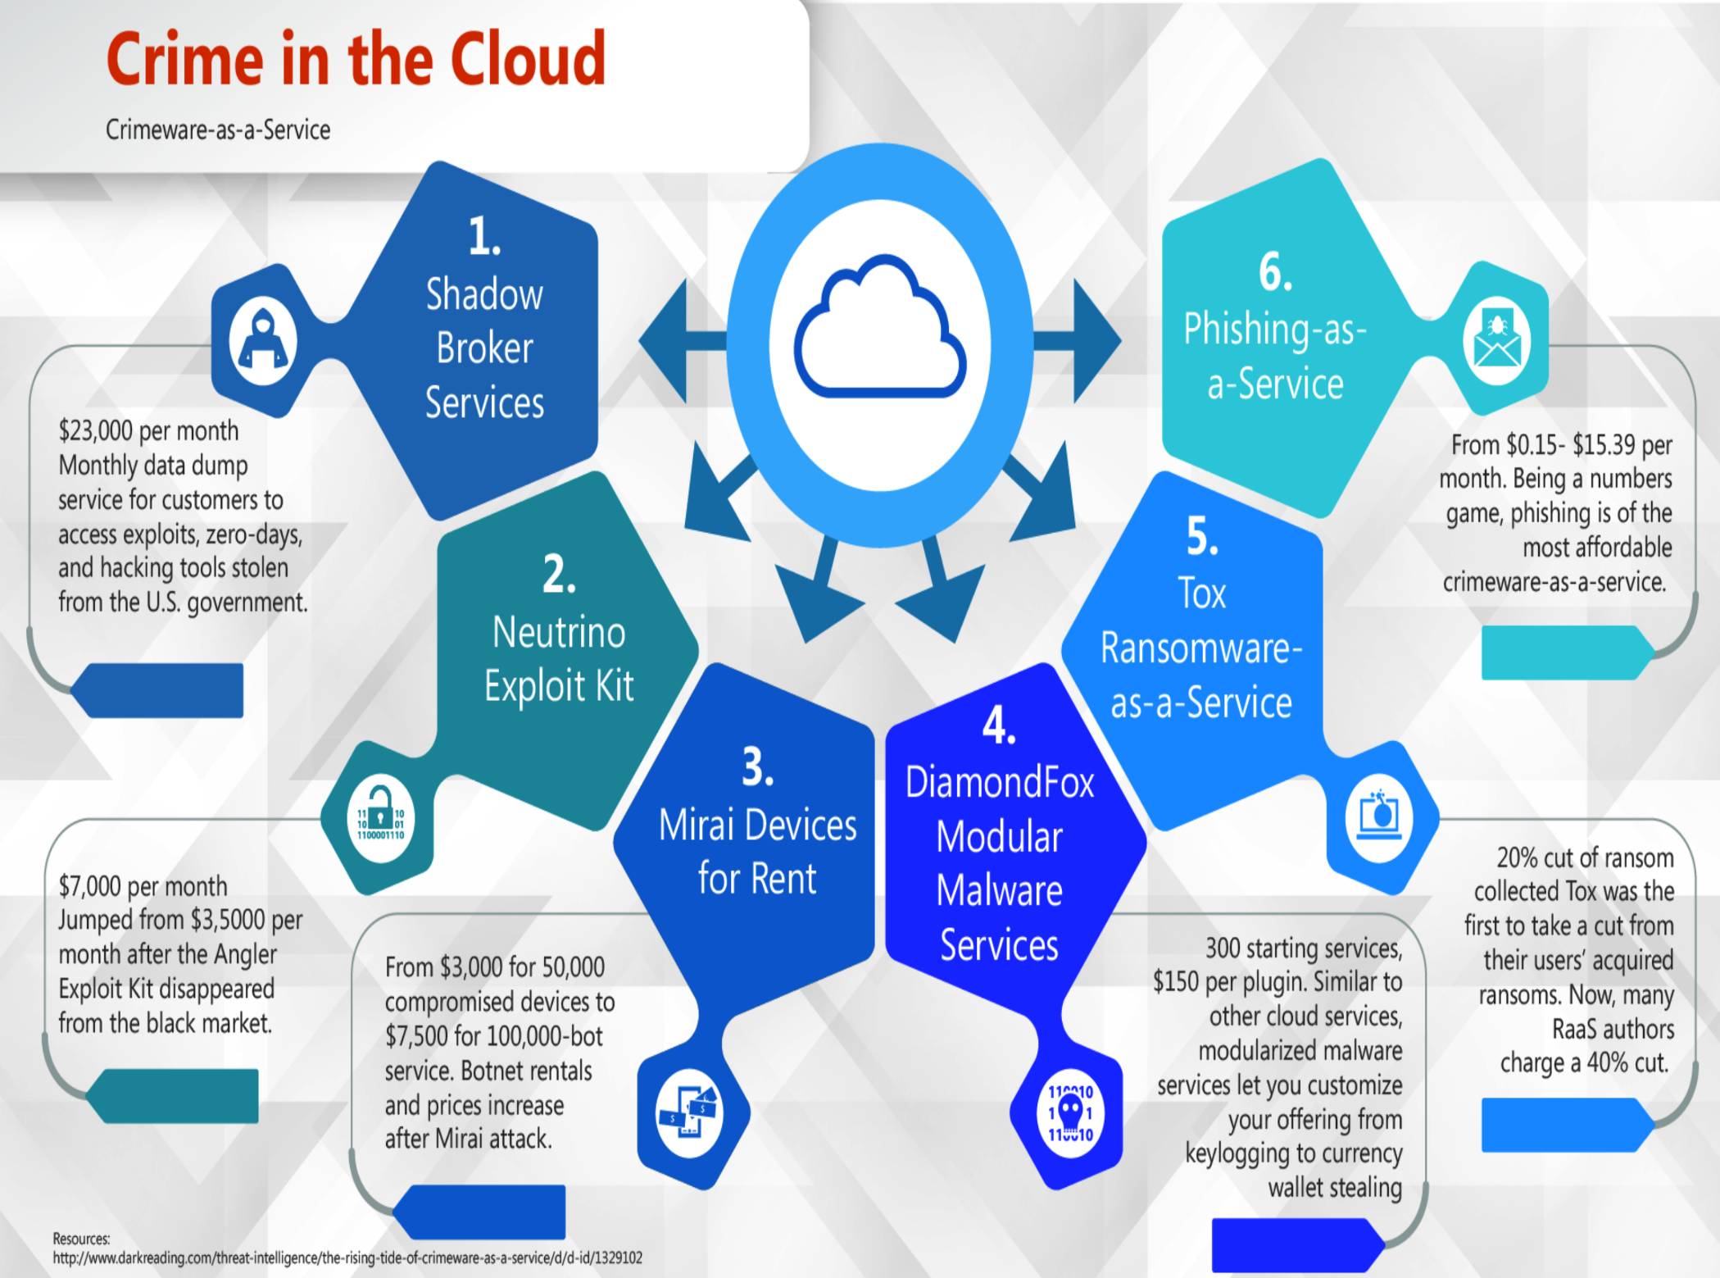
Notes:
No of end devices that are connected to internet are expected to rise above 50+ billion by 2020.
cloud computing architectures won’t be able to handle the demand of the Internet of things
So only cloud is not the optimal solution to handle this massive explosion.
Fog is needed in between to optimize – need for an interplay of cloud and fog.

Slide 62
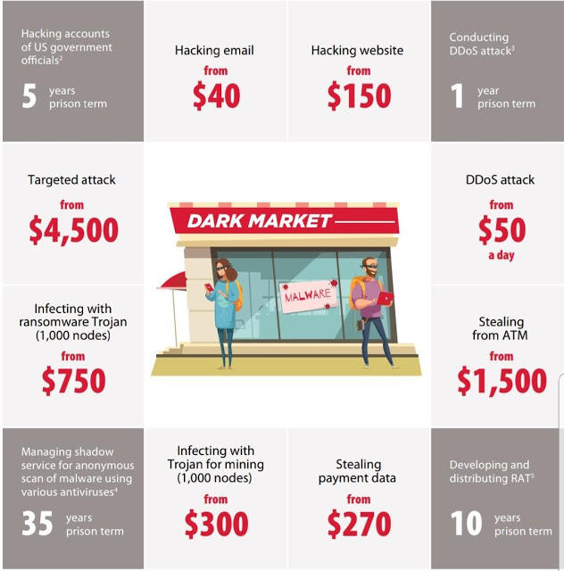
Notes:
No of end devices that are connected to internet are expected to rise above 50+ billion by 2020.
cloud computing architectures won’t be able to handle the demand of the Internet of things
So only cloud is not the optimal solution to handle this massive explosion.
Fog is needed in between to optimize – need for an interplay of cloud and fog.

Slide 63
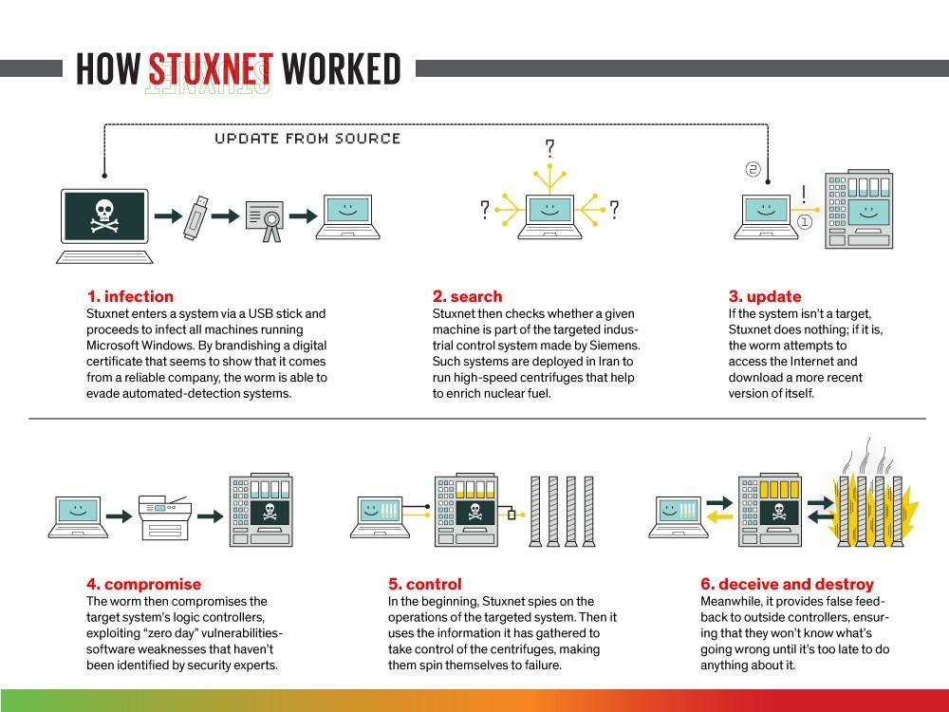
Information Security
Office of Budget and Finance
Education – Partnership – Solutions
Notes:
And is there concern about IoT, given the concepts of privacy and security in today’s digital age? We may look at how media presents technology in both positive and negative lights.

Slide 64
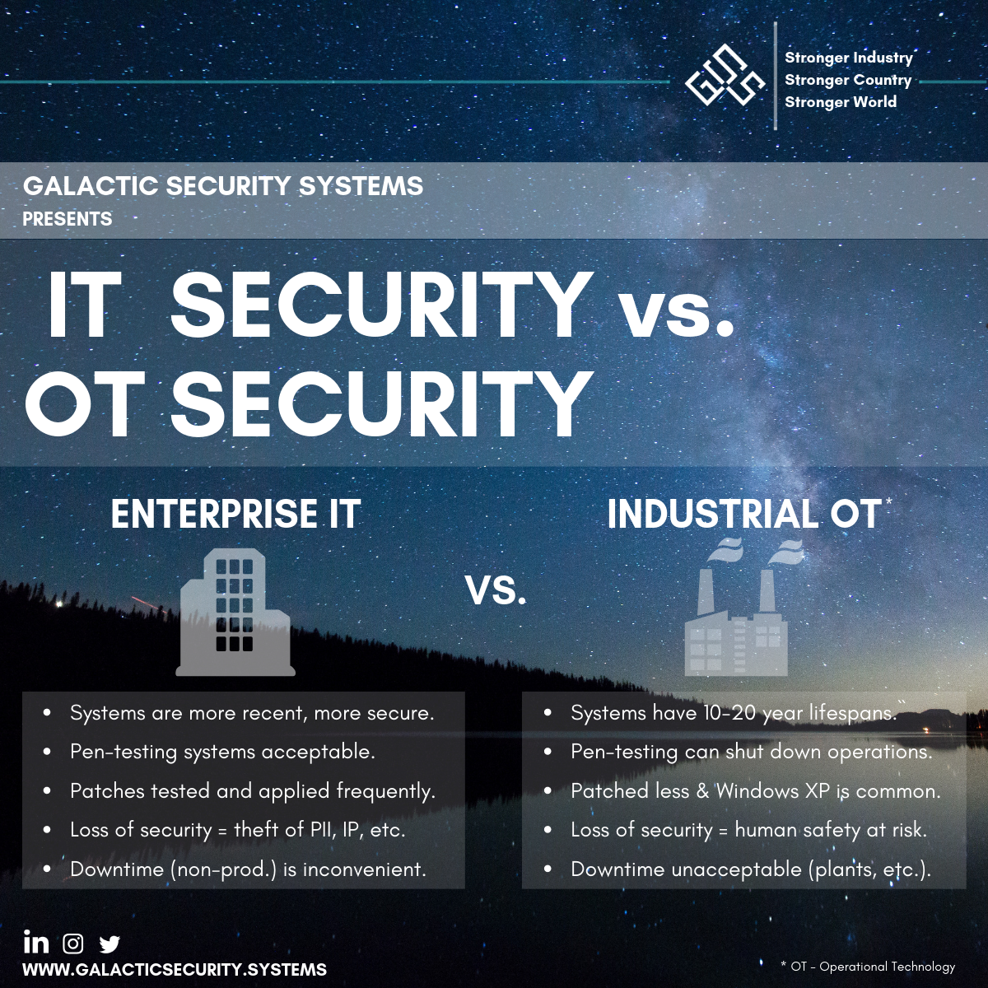
Notes:
No of end devices that are connected to internet are expected to rise above 50+ billion by 2020.
cloud computing architectures won’t be able to handle the demand of the Internet of things
So only cloud is not the optimal solution to handle this massive explosion.
Fog is needed in between to optimize – need for an interplay of cloud and fog.

Slide 65
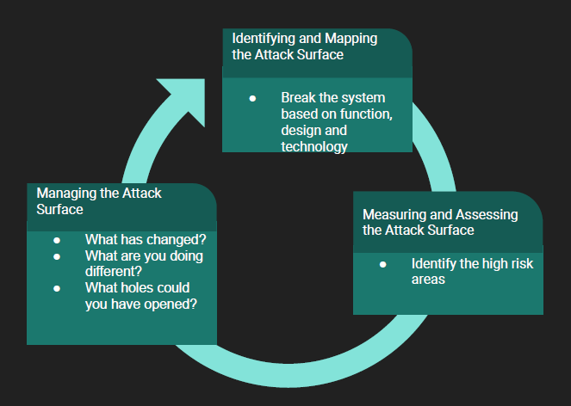
Information Security
Office of Budget and Finance
Education – Partnership – Solutions
Notes:
And is there concern about IoT, given the concepts of privacy and security in today’s digital age? We may look at how media presents technology in both positive and negative lights.

Slide 66
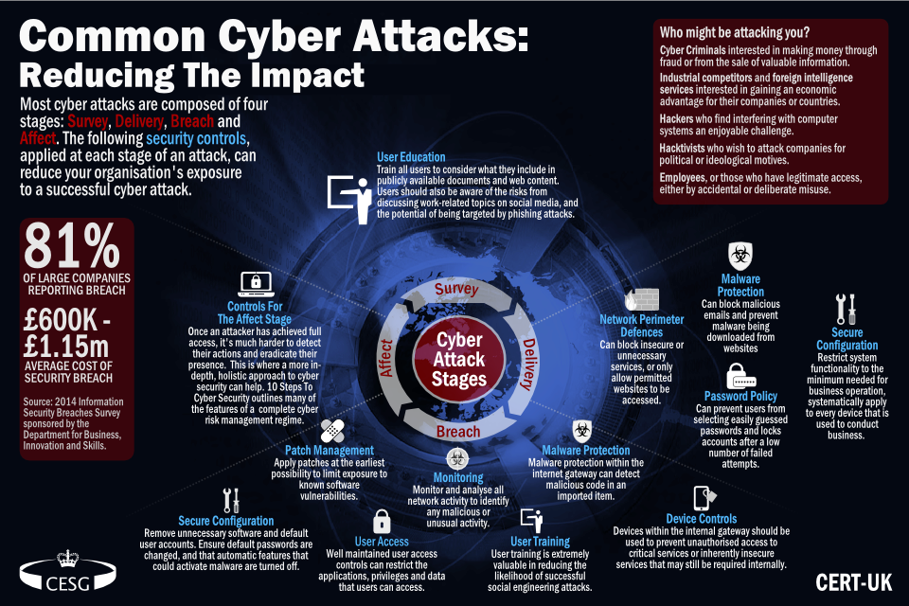
Information Security
Office of Budget and Finance
Education – Partnership – Solutions
Notes:
And is there concern about IoT, given the concepts of privacy and security in today’s digital age? We may look at how media presents technology in both positive and negative lights.

Slide 67
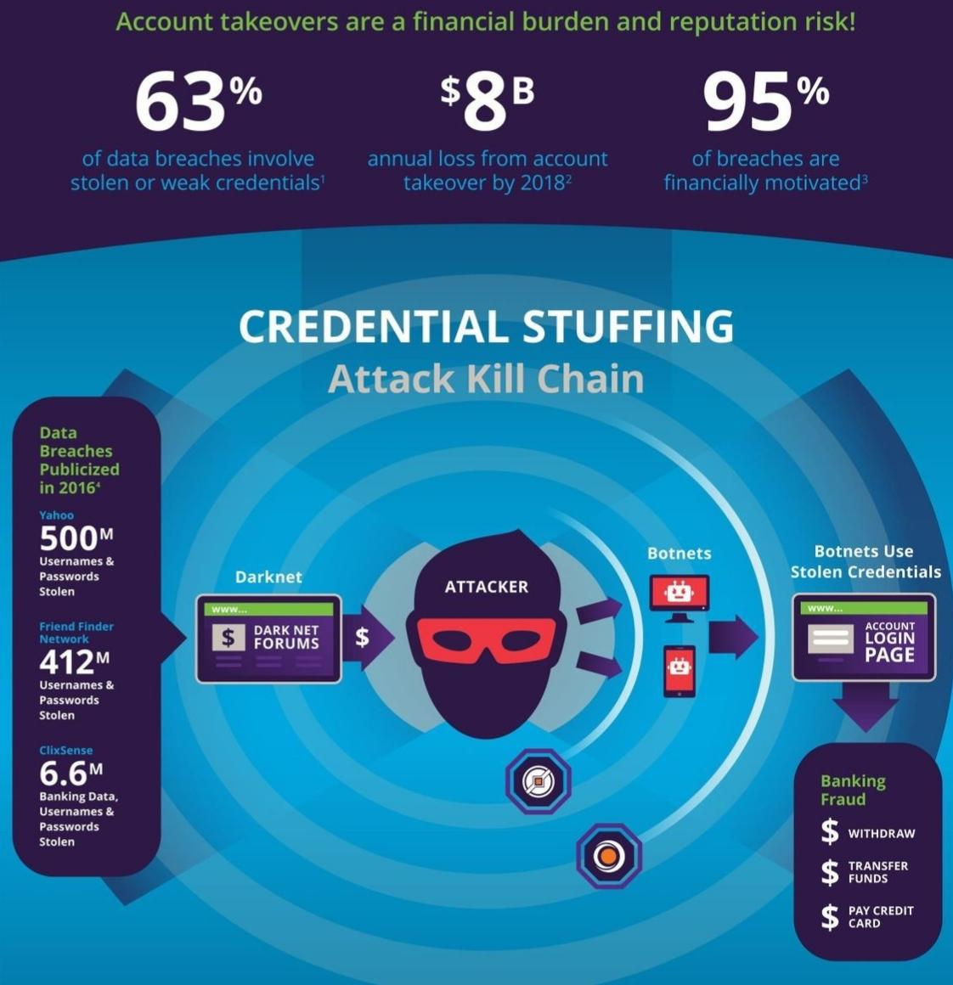
Information Security
Office of Budget and Finance
Education – Partnership – Solutions
Notes:
And is there concern about IoT, given the concepts of privacy and security in today’s digital age? We may look at how media presents technology in both positive and negative lights.

Slide 68
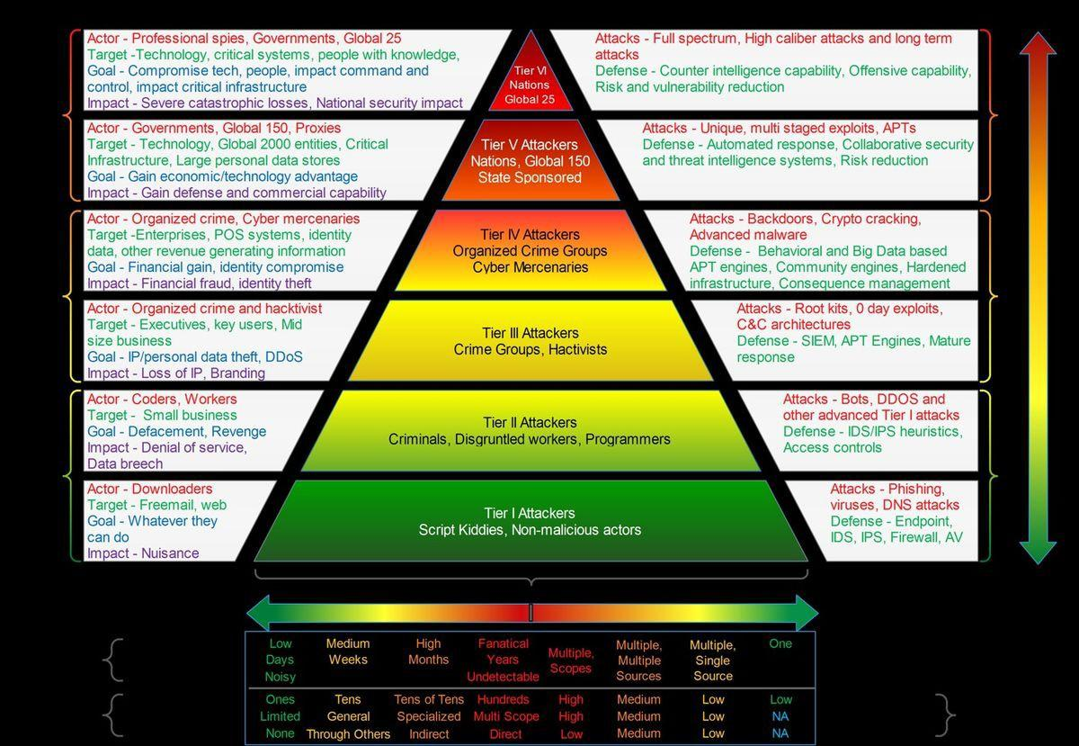
Information Security
Office of Budget and Finance
Education – Partnership – Solutions
Notes:
And is there concern about IoT, given the concepts of privacy and security in today’s digital age? We may look at how media presents technology in both positive and negative lights.

Slide 69
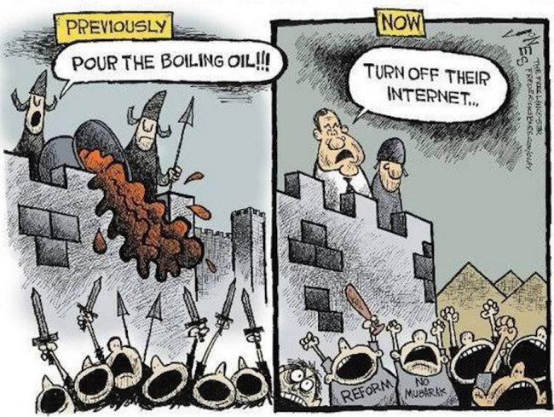
Information Security
Office of Budget and Finance
Education – Partnership – Solutions
Notes:
And is there concern about IoT, given the concepts of privacy and security in today’s digital age? We may look at how media presents technology in both positive and negative lights.

Slide 70

Information Security
Office of Budget and Finance
Education – Partnership – Solutions
Notes:
And is there concern about IoT, given the concepts of privacy and security in today’s digital age? We may look at how media presents technology in both positive and negative lights.

Slide 71

Information Security
Office of Budget and Finance
Education – Partnership – Solutions
Notes:
And is there concern about IoT, given the concepts of privacy and security in today’s digital age? We may look at how media presents technology in both positive and negative lights.

Slide 72

Notes:
No of end devices that are connected to internet are expected to rise above 50+ billion by 2020.
cloud computing architectures won’t be able to handle the demand of the Internet of things
So only cloud is not the optimal solution to handle this massive explosion.
Fog is needed in between to optimize – need for an interplay of cloud and fog.

Slide 73

Notes:
No of end devices that are connected to internet are expected to rise above 50+ billion by 2020.
cloud computing architectures won’t be able to handle the demand of the Internet of things
So only cloud is not the optimal solution to handle this massive explosion.
Fog is needed in between to optimize – need for an interplay of cloud and fog.

Slide 74

Notes:
No of end devices that are connected to internet are expected to rise above 50+ billion by 2020.
cloud computing architectures won’t be able to handle the demand of the Internet of things
So only cloud is not the optimal solution to handle this massive explosion.
Fog is needed in between to optimize – need for an interplay of cloud and fog.

Slide 75

Why be concerned about IoT?
Information Security
Office of Budget and Finance
Education – Partnership – Solutions
It’s just another computer, right?
All of the same issues we have with access control, vulnerability management, patching, monitoring, etc.
Imagine your network with 1,000,000 more devices
Any compromised device is a foothold on the network
Notes:
Like all new technology, the Internet of Things brings both a beneficial and disruptive element. With the concept of “always-on”, such technology will require a change in mindset when considering implementation of products and services related to IoT. Since IoT is more and more an element in the daily lives of individuals and organizations, maintaining both privacy, security and business operations/opportunities will be more of a priority both today and in the future.

Slide 76
Does IoT add additional risk?
Information Security
Office of Budget and Finance
Education – Partnership – Solutions
Are highly portable devices captured during vulnerability scans?
Where is your network perimeter?
Are consumer devices being used in areas – like health care – where reliability is critical?
Do users install device management software on other computers? Is that another attack vector?
Notes:
How visible will IoT devices be considering identification through network vulnerability scans?
What defines a network perimeter or “edge”
How are consumer devices thorough BYOD policies used in sensitive areas?
Since IoT is more and more an element in the daily lives of individuals and organizations, maintaining both privacy, security and business operations/opportunities will be more of a priority both today and in the future. : IoT are not generic items or auxiliary services like those that have been prevalent in business for years; rather, IoT devices should be considered as unique devices, each with a distinct set of security risks. Both security controls as well as security training necessary to effectively manage IoT devices may not yet be fully developed.

Slide 77

Attacking IoT
Information Security
Office of Budget and Finance
Education – Partnership – Solutions
Default, weak, and hardcoded credentials
Difficult to update firmware and OS
Lack of vendor support for repairing vulnerabilities
Vulnerable web interfaces (SQL injection, XSS)
Coding errors (buffer overflow)
Clear text protocols and unnecessary open ports
DoS / DDoS
Physical theft and tampering
Notes:
Issues that are common when attacking IoT infrastructure is similar to current levels of attacks that are currently experienced today. The avenue of how attacks may occur may however be through untraditional methods:
It may be more often to find default, weak, and hardcoded credentials (usernames passwords) within IoT devices
The issue of upgrading firmware to counter vulnerabilities may be dependent both upon how devices are designed during development; issues may occur that upgrading may break functionality. For this reason, vendors may be hesitate or refuse to render support in product lines and make adjustments during the next design phase of projects.
Certain IoT devices with embedded web services may also be subject to the same vulnerabilities that commonly plague web server platforms today; also with the premise that updating such functionality may run into the same issues such as
Buffer overflows are quite common vulnerabilities within technology infrastructure, with IoT no exception.
Devices may also at times use protocols that transmit credentials in the clear, in addition to having open ports
DOS/DDOS attacks may be the results in hacking or hijacking IoT devices on network(s); it also possible that through misconfigurations of IoT devices that such “attacks” may be false positives and cause business disruption
The issue of physical attacks of IoT devices may result in tampering to inject malicious code or make hardware modifivcations to IoT devices. In addition, impersonating or counterfeiting devices may be issues when safeguards are not in place to protect physical security.
Infiltration through non-traditional communication protocols; such as Bluetooth, Zigbee, Zwave, Sigfox, NFC, 6LowPAN, and other types of non traditional wireless communication outside of Wifi. communication protocols as well that may not be within scope through common incident and forensic management tools.
Cross-site scripting – certain IoT devices may have embedded web server technology, putting them at risk
Buffer overflows – design flaws that may not be immediately corrected because of patching mechanisms, developmental issues during the SDLC process
Open ports – common issue on device ports that are not locked down and may be used via reconnaissance.

Slide 78

Information Security
Office of Budget and Finance
Education – Partnership – Solutions
Notes:
And is there concern about IoT, given the concepts of privacy and security in today’s digital age? We may look at how media presents technology in both positive and negative lights.

Slide 79
OWASP IoT Project
An overall IoT security effort
Attack surfaces (present)
Vulnerability lists (working)
Reference solutions (coming)
Aggregates community resources
Guidance for developers
IoT specific security principles
IoT framework assessment

Slide 80
OWASP IoT Top 10
Category | IoT Security Consideration | Recommendations
I1: Insecure Web Interface | Ensure that any web interface coding is written to prevent the use of weak passwords … | When building a web interface consider implementing lessons learned from web application security. Employ a framework that utilizes security …
I2: Insufficient Authentication/Authorization | Ensure that applications are written to require strong passwords where authentication is needed … | Refer to the OWASP Authentication Cheat Sheet
I3: Insecure Network Services | Ensure applications that use network services don't respond poorly to buffer overflow, fuzzing … | Try to utilize tested, proven, networking stacks and interfaces that handle exceptions gracefully...
I4: Lack of Transport Encryption | Ensure all applications are written to make use of encrypted communication between devices… | Utilize encrypted protocols wherever possible to protect all data in transit…
I5: Privacy Concerns | Ensure only the minimal amount of personal information is collected from consumers … | Data can present unintended privacy concerns when aggregated…
I6: Insecure Cloud Interface | Ensure all cloud interfaces are reviewed for security vulnerabilities (e.g. API interfaces and cloud-based web interfaces) … | Cloud security presents unique security considerations, as well as countermeasures. Be sure to consult your cloud provider about options for security mechanisms…
I7: Insecure Mobile Interface | Ensure that any mobile application coding is written to disallows weak passwords … | Mobile interfaces to IoT ecosystems require targeted security. Consult the OWASP Mobile …
I8: Insufficient Security Configurability | Ensure applications are written to include password security options (e.g. Enabling 20 character passwords or enabling two-factor authentication)… | Security can be a value proposition. Design should take into consideration a sliding scale of security requirements…
I9: Insecure Software/Firmware | Ensure all applications are written to include update capability and can be updated quickly … | Many IoT deployments are either brownfield and/or have an extremely long deployment cycle...
I10: Poor Physical Security | Ensure applications are written to utilize a minimal number of physical external ports (e.g. USB ports) on the device… | Plan on having IoT edge devices fall into malicious hands...

Slide 81
Principles of IoT Security
Assume a hostile edge
Test for scale
Internet of lies
Exploit autonomy
Expect isolation
Protect uniformly
Encryption is tricky
System hardening
Limit what you can
Lifecycle support
Data in aggregate is unpredictable
Plan for the worst
The long haul
Attackers target weakness
Transitive ownership
N:N Authentication

Slide 82

Information Security
Office of Budget and Finance
Education – Partnership – Solutions
Notes:
And is there concern about IoT, given the concepts of privacy and security in today’s digital age? We may look at how media presents technology in both positive and negative lights.

Slide 83

Information Security
Office of Budget and Finance
Education – Partnership – Solutions
Notes:
And is there concern about IoT, given the concepts of privacy and security in today’s digital age? We may look at how media presents technology in both positive and negative lights.

Slide 84

Edge-Fog Computing
Notes:
Fog computing is making use of decentralized servers in between network core and network edge for data processing and to serve the immediate requirements of the end systems.
Does this replace the cloud?
No,
Fog computing is non-trivial extension of Cloud computing paradigm to the edge of the network.
Network edge: applications and hosts, routers close to end systems in the internet; Network core: interconnected routers in the internet, network of networks
fog nodes can be deployed anywhere with a network connection: on a factory floor, on top of a power pole,
alongside a railway track, in a vehicle, or on an oil rig. Any device with computing, storage, and network
connectivity can be a fog node. Examples include industrial controllers, switches, routers, embedded servers, and
video surveillance cameras.

Slide 85
Need for Edge-Fog computing
Why can’t do all in cloud?
Cloud computing frees the enterprise and the end user from many details.
This bliss becomes a problem for latency-sensitive applications.
Why can’t do all in end systems?
Physical constraints: Energy, space, etc.,
Notes:
Iot is generating unprecedented volume and variety of data, by the time it makes to the cloud for analysis, the opportunity to act upon the data might be gone.
Also, Loads of useless data are been pushed to the cloud. Fog filters out and sends useful data to clouds.
Anyway, these are a few examples, we see key attributes of fog computing later in the slides.
End systems might be sensors, actuators could be stolen.

Slide 86
Key attributes of Edge-Fog computing
The Use Cases that were discussed brings up a # of attributes that differentiate Fog computing platform from the Cloud.
Applications that require very low and predictable latency. (STLS, SCV)
Geo-distributed applications (pipeline monitoring, STLS)
Fast mobile applications (Smart connected vehicle, rail)
Large-scale distributed control systems (STLS, smart grid)
IoT also brings Big Data with a twist: rather than high volume, the number of data sources distributed geographically
Notes:
These attributes do not apply uniformly to every use case.
Mobility, for instance, a critical attribute in Smart Connected Vehicle and Connected Rail, plays no role in STLS and Wind Farm cases.
Analyzing data close to the device that collected the data can make the difference
between averting disaster and a cascading system failure.

Slide 87
Geo-distribution: A new Dimension of Big Data
3 Dimensions: Volume, Velocity and Variety.
IoT use cases: STLS, Connected Rail, pipeline monitoring are naturally distributed.
This suggests to add a 4th dimension: geo-distribution.
Since challenge is to manage number of sensors(and actuators) that are naturally distributed as a coherent whole.
Call for “moving the processing to the data”
A distributed intelligent platform at the Edge(Fog computing) that manages distributed compute, networking, and storage resources.

Slide 88

The Edge(Fog) and the core(Fog) interplay: Many uses of same data
Notes:
Only certain useful data is being sent to the cloud from fog for further processing, instead of bombarding clouds with irrelevant data.

Slide 89

Fog Software Architecture
Notes:
The use cases and the requirements discussed in previous sections help nail down the following key objectives of the Fog software architecture:
Fog nodes are heterogeneous in nature and deployed in variety of environments including core, edge, access networks and endpoints.
Fog architecture should facilitate seam less resource management across diverse set of platforms.
The fog platform host diverse set of applications belonging to various verticals- SCV, smart grid etc.
Fog architecture exposes generic APIs that can be used by diverse set of applications to leverage fog platform.
Fog platform should support policy based-orchestration for scalable management of individual subsystems and the overall service.

Slide 90
Example Edge Considerations
Are communications encrypted?
Is storage encrypted?
How is logging performed?
Is there an updating mechanism?
Are there default passwords?
What are the offline security features?
Is transitive ownership addressed?

Slide 91

Notes:
No of end devices that are connected to internet are expected to rise above 50+ billion by 2020.
cloud computing architectures won’t be able to handle the demand of the Internet of things
So only cloud is not the optimal solution to handle this massive explosion.
Fog is needed in between to optimize – need for an interplay of cloud and fog.

Slide 92
Example Gateway Considerations
Is encryption interrupted?
Is there replay and denial of service defensive capabilities?
Is there local storage? Is it encrypted?
Is there anomaly detection capability?
Is there logging and alerting?

Slide 93

Notes:
No of end devices that are connected to internet are expected to rise above 50+ billion by 2020.
cloud computing architectures won’t be able to handle the demand of the Internet of things
So only cloud is not the optimal solution to handle this massive explosion.
Fog is needed in between to optimize – need for an interplay of cloud and fog.

Slide 94

Notes:
No of end devices that are connected to internet are expected to rise above 50+ billion by 2020.
cloud computing architectures won’t be able to handle the demand of the Internet of things
So only cloud is not the optimal solution to handle this massive explosion.
Fog is needed in between to optimize – need for an interplay of cloud and fog.

Slide 95

Notes:
No of end devices that are connected to internet are expected to rise above 50+ billion by 2020.
cloud computing architectures won’t be able to handle the demand of the Internet of things
So only cloud is not the optimal solution to handle this massive explosion.
Fog is needed in between to optimize – need for an interplay of cloud and fog.

Slide 96
Illustrative Use Cases to Drive Edge-Fog computing
Use Case 1: A smart Traffic Light System (STLS)
Use Case 2: Wind Farms
To abstract the major requirements to propose an architecture that addresses a vast majority of the IoT requirements.

Slide 97
Use Case 1: A Smart Traffic Light System(STLS)
System Outline:
STLS calls for deployment of a STL at each intersection.
The STL is equipped with sensors that
Measure the distance and speed of approaching vehicles from every direction.
Detect presence of pedestrians/other vehicles crossing the street.
- Issues “Slow down” warnings to vehicles at risk to crossing in red and even modifies its own cycle to prevent collisions.
Notes:
STLS: smart traffic light system
STLS is a small piece of the full-fledged system envisioned by smart connected vehicle(SCV). Meaning…
Anyway, the system outline…

Slide 98
STLS: System outline continued..
STLS has 3 major goals:
Accidents prevention
Maintenance of steady flow of traffic(green waves along the main roads)
Collection of relevant data to evaluate and improve the system
Note:
Goal (1) requires real-time reaction, (2) near-real time, and (3) relates to the collection and analysis of global data over long periods.
Notes:
May be to give idea: https://www.youtube.com/watch?v=kh7X-UKm9kw
To be effective, the local control loop subsystem must react within a few milliseconds – thus illustrating the role of the Fog in supporting low latency applications.

Slide 99
Key requirements driven by STLS
Local Subsystem latency:- Reaction time needed is in the order of < 10 milliseconds.
Middleware orchestration platform:- Middleware to handle a # of critical software components. A. Decision maker(DM), B. message bus.
Networking infrastructure:- Fog nodes belongs to a family of modular compute and storage devices.
Interplay with the cloud:- Data must be injected into a Data center/ cloud for deep analysis to identify patterns in traffic, city pollutants.
Notes:
Orchestration is the automated arrangement, coordination, and management of computer systems, middleware, and services.
Orchestration also provides centralized management of the resource pool, including billing, metering, and chargeback for consumption.
For example, orchestration reduces the time and effort for deploying multiple instances of a single application. And as the requirement for more resources or a new application is triggered, automated tools now can perform tasks that previously could only be done by multiple administrators operating on their individual pieces of the physical stack

Slide 100
STLS Key requirements, cont’d.
Consistency of a highly distributed system:- Need to be Consistent between the different aggregator points.
Multi-tenancy:- It must provide strict service guarantees all the time.
Multiplicity of providers:- May extend beyond the borders of a single controlling authority. Orchestration of consistent policies involving multiple agencies is a challenge unique to Fog Computing.

Slide 101
Use case 2: Wind Farm
Brings up requirements shared by a number of Internet of Everything(IoE) deployments:
Interplay between real time analytics and batch analytics.
Tight interaction between sensors and actuators, in closed control loops.
Wide geographical deployment of a large system consistent of a number of autonomous yet coordinated modules – which gives rise to the need of an orchestration platform.
Notes:
Orchestration is the automated arrangement, coordination, and management of computer systems, middleware, and services.
There is a need for orchestration platform since these type of systems are distributed across wide geographical regions.

Slide 102
System outline:
There are 4 typical regions:
Region1: Wind speed is very low(say, 6m/sec), not so economical to run the turbine.
Region2: Normal operating condition(winds between 6-12m/sec), so maximum conversion of wind power into electrical power.
Region3: Winds exceed 12 m/sec, power is limited to avoid exceeding safe electrical and mechanical loads.
Region4: Very high wind speeds above 25 m/sec, here turbine is powered down to avoid excessive operating loads.
Notes:
A large wind farm consists of several hundreds of wind turbines, and cover an area of hundreds of square miles.
Modern wind turbine are very large flexible structures that are equipped with several control loops that aim at improving wind power capture(actual/full capaticity) as well as reducing structural loading. In short they try to increase efficiency and to stop it minimize wear and prevent damages.
Note that global co-ordination is required at the farm level for maximum efficiency.

Slide 103
Key requirements driven by Wind Farm
Network Infrastructure: An efficient communication network between sub-systems, system and the internet (cloud)
Global controller: gathering data, building the global state, determining the policy.
Middle Orchestration platform: A middleware that mediates between sub-systems and the cloud.
Data analytics: (1) requires real-time reaction, (2) near-real time, and (3) relates to the collection and analysis of global data over long periods.

Slide 104

Notes:
No of end devices that are connected to internet are expected to rise above 50+ billion by 2020.
cloud computing architectures won’t be able to handle the demand of the Internet of things
So only cloud is not the optimal solution to handle this massive explosion.
Fog is needed in between to optimize – need for an interplay of cloud and fog.

Slide 105

Notes:
No of end devices that are connected to internet are expected to rise above 50+ billion by 2020.
cloud computing architectures won’t be able to handle the demand of the Internet of things
So only cloud is not the optimal solution to handle this massive explosion.
Fog is needed in between to optimize – need for an interplay of cloud and fog.

Slide 106

Information Security
Office of Budget and Finance
Education – Partnership – Solutions
Notes:
And is there concern about IoT, given the concepts of privacy and security in today’s digital age? We may look at how media presents technology in both positive and negative lights.

Slide 107

Notes:
No of end devices that are connected to internet are expected to rise above 50+ billion by 2020.
cloud computing architectures won’t be able to handle the demand of the Internet of things
So only cloud is not the optimal solution to handle this massive explosion.
Fog is needed in between to optimize – need for an interplay of cloud and fog.

Slide 108
Cloud Service Models
Infrastructure as a Service (IaaS)
Standardized, highly automated offering, where compute resources, complemented by storage and networking capabilities are owned by a service provider and offered to customers on-demand. Customers are able to self-provision the infrastructure.
Platform as a Service (PaaS)
Offering is a broad collection of application infrastructure (middleware) services including application platform, integration, business process management and database services.
Software as a Service (SaaS)
Software is owned, delivered and managed remotely by a provider. The provider delivers software based on one set of common code and data definitions that is by contracted customers on a pay-for-use basis or as a subscription.

Slide 109
Cloud Computing
Packaged Software
Infrastructure
(as a Service)
Platform
(as a Service)
Software
(as a Service)
Applications
Applications
You manage
Applications
Applications
Data
You manage
Data
Data
Data
Runtime
Runtime
Runtime
Runtime
Middleware
Middleware
Middleware
Middleware
Managed by vendor
You manage
O/S
O/S
O/S
Managed by vendor
O/S
Virtualization
Virtualization
Managed by vendor
Virtualization
Virtualization
Servers
Servers
Servers
Servers
Storage
Storage
Storage
Storage
Networking
Networking
Networking
Networking
Notes:
Slide Objectives:
Explain the differences and relationship between IaaS, PaaS, and SaaS in more detail.
Speaking Points:
Here’s another way to look at the cloud services taxonomy and how this taxonomy maps to the components in an IT infrastructure.
Packaged Software
With packaged software a customer would be responsible for managing the entire stack – ranging from the network connectivity to the applications.
IaaS
With Infrastructure as a Service, the lower levels of the stack are managed by a vendor. Some of these components can be provided by traditional hosters – in fact most of them have moved to having a virtualized offering.
Very few actually provide an OS
The customer is still responsible for managing the OS through the Applications.
For the developer, an obvious benefit with IaaS is that it frees the developer from many concerns when provisioning physical or virtual machines.
This was one of the earliest and primary use cases for Amazon Web Services Elastic Cloud Compute (EC2).
Developers were able to readily provision virtual machines (AMIs) on EC2, develop and test solutions and, often, run the results ‘in production’.
The only requirement was a credit card to pay for the services.
PaaS
With Platform as a Service, everything from the network connectivity through the runtime is provided and managed by the platform vendor.
The Windows Azure best fits in this category today.
In fact because we don’t provide access to the underlying virtualization or operating system today, we’re often referred to as not providing IaaS.
PaaS offerings further reduce the developer burden by additionally supporting the platform runtime and related application services.
With PaaS, the developer can, almost immediately, begin creating the business logic for an application.
Potentially, the increases in productivity are considerable and, because the hardware and operational aspects of the cloud platform are also managed by the cloud platform provider, applications can quickly be taken from an idea to reality very quickly.
SaaS
Finally, with SaaS, a vendor provides the application and abstracts you from all of the underlying components.

Slide 110
Cloud Service Models
Presentment
Application Programming Interfaces
Software as a Service
Applications/Software
Data
Metadata
Integration
Platform as a Service
Middleware
Interfaces
Connectivity/Network
Abstraction Layer
Infrastructure as a Service
Hardware
Facilities

Slide 111
Cloud Deployment Models
Public
Cloud infrastructure is available to the general public, owned by org selling cloud services
Private
Cloud infrastructure for single organization only, may be managed by the organization or a 3rd party, on or off premise
Hybrid
Cloud infrastructure shared by several organizations that have shared concerns, managed by org or 3rd party
Community
Combinations of clouds types

Slide 112










Journey to Agile Integrated Infrastructure
Modern Data Center Environment: Elastic, Scalable, Efficient, Fast
Traditional IT
Private Cloud
Public Cloud
Off Premise
Cloud Native Apps
Core Apps
Elastic Capability
Cloud Core Apps
Elastic Capa-city
Cloud Native Apps
Servers
Storage
Networking
Power & Cooling
Hyper-Converged
Infrastructure
AGILE
INFRASTRUCTURE
Virtualization
& Converged Infrastructure
Flash
Orchestration & Automation
Burst
Flexible
Self Service
On Premise
Hosted Private Cloud
Public Cloud

Slide 113
Shared Security Responsibility
Service Provider and Consumer roles, related to cloud model, are inverse of each other.
Consumer
IAAS
PAAS
SAAS
SAAS
Application
PAAS
Platform Architecture
Virtual Infrastructure
IAAS
Hardware
Facility
Service Provider

Slide 114
Endpoint Device Security
Host based Intrusion Detection Systems (HIDS)
Host based firewalls
Application whitelisting
Endpoint encryption
Trusted platform module
Mobile device management
Sandboxing

Slide 115
Cloud Security
TLS Encryption
Network Firewalls/Web Application Firewall
Data Encryption – FIPS 140-2
Central Logging
Authentication Layering
Network Scanning
Third Party Security Testing
Vulnerability Assessments
Penetration Testing
Security Audit
Statement on Standards for Attestation Engagements (SSAE) 16 Compliant Data Center

Slide 116
Cloud Governance
Cloud Governance by the Customer is Critical
Extend organizational practices pertaining to the policies, procedures, and standards implemented for users.
Practices pertaining to policies, procedures and standards implemented for application development and service provisioning.
Environment establishment such as development, testing, staging, training, production and disaster recovery in alignment with organizational standards.
Put in place audit mechanisms and tools to ensure organizational practices are followed such as log review and reporting.

Slide 117
Cloud Governance
Cloud Governance by the Customer is Critical
Cloud Customers need to define cloud strategy before entering into agreement with CSP
Organizational assets agreed upon and assessed for suitability for cloud
Define suitable business units or functions
Outline phased approach to cloud journey
Document exceptions, restrictions, and risks
List regulatory and compliance components (addressed either jointly or by the provider)
List business and system interdependencies.

Slide 118
Cloud Application Security
Cloud development and applications must take into consideration service models and deployment models
Data sensitivity issues in cloud
Use RESTful vs SOAP APIs
Careful with multitenancy
Appropriate cryptography
Release management

Slide 119
Cloud Application Security
On-premises does not always port
Should follow appropriate Software Development Lifecycle
Not all applications are suitable for the cloud
Users and developers must understand and have appropriate security awareness
Document cloud applications thoroughly
Identify complexities of integration
Code for 2019 OWASP TOP 10 in mind
Code for ISO/IEC 27034-1 Information Technology – Security Techniques

Slide 120
Cloud Application Security
APIs are a very important part of cloud applications
Primary access method
Two of the possible formats for cloud APIs are:
Representational State Transfer (REST)
Uses HTTP
Supports many data formats (e.g., JSON, XML, YAML, etc.)
Good performance and scalability, uses caching
Widely used
Stateless
Simple Object Access Protocol (SOAP)
Uses SOAP envelope around HTTP, FTP, or SMTP
Only supports XML
Slower performance, complex scalability, no caching
Used where REST is not possible
Stateful

Slide 121
Cloud Operations & Maintenance
It is critical to research the cloud operations and maintenance of the cloud service provider to ensure they are operating appropriately for compliance and risk threshold.
You cannot assume that because they say they operate it appropriately they do.
Ask for patching schedules.
What type of continuous scanning is done and can you have a summary report.
And ensure the following:

Slide 122
Cloud Operations & Maintenance
Fault management
Problem management
Equipment management
Change management
Release management
Supplier management
Prevention management
Resource staffing
Architectural/network topology documentation

Slide 123
Cloud Compliance
Align compliance requirements developed from regulations, standards, and organization mission to create a framework for acceptable:
Risk: Have risk management in place supported by leadership
Recovery Time Objective: How long can the system or components be down?
Recovery Point Objective: How much data can you lose before reaching the unacceptable threshold
Loss: Are there acceptable losses?
Budget: For losses, fines or hopefully controls
Controls: Dependent on identified risk and vulnerabilities.

Slide 124
Cloud Compliance
Customer chooses where to place data.
Customer organization needs to understand cloud computing.
Cloud providers generally have regions that are isolated by design
Data is not replicated to other regions does not move unless the customer chooses that option
Customers manage access to their data as well as services and resources
Customers choose how their data is secured.

Slide 125
Some Key Points
Make sure you exercise due diligence when selecting a cloud service provider.
Make sure the cloud environment supports the regulatory requirements of your industry and data.
Conduct data classification to understand the sensitivity of your data before moving to the cloud.
Clearly define who owns the data and how it will be “returned” to you and the timing in the event you cancel your agreement.
Understand if you are leveraging the cloud in IaaS, PaaS, SaaS or other model.
Establish Service Level Agreements (SLAs) to ensure performance
Engage Cloud specific legal advice before moving to the cloud.

Slide 126
Some Key Points
Make sure your you schedule enough time to move your application or data center to the cloud.
Make sure you budget a sufficient amount.
Recognize that many organizational policies and procedures will need to be updated.
When using data provided by 3rd parties note that you may need to notify and append your agreement.
Do not let the IT skill level, who understands the business and your applications, weaken.

Slide 127
Architectural Considerations
Attack Surface.
The hypervisor is an additional layer of software between an operating system and hardware platform. The hypervisor normally supports other application programming interfaces to conduct administrative operations, such as launching, migrating, and terminating virtual machine instances. This increases the attack surface.
Complicated Architectures
Virtual machines environments and their supportive software are complicated. Implementing organizational software in PaaS or IaaS creates additional complications that have to managed appropriately

Slide 128
Architectural Considerations
Virtual Network Protection
Most virtualization platforms have the ability to create software-based switches and network configurations as part of the virtual environment to allow virtual machines on the same host to communicate more directly and efficiently. Some hypervisors’ network monitoring capabilities are not as robust as physical network tools.
Virtual Machine Images.
IaaS cloud providers maintain repositories of virtual machine images. A virtual machine image includes a the software stack and speeds up the time to implementation. These are often shared. Shared virtual images must be validated and carefully controlled to not implement problems.

Slide 129
Architectural Considerations
Client-Side Protection
Web browsers, a key element for many cloud computing services, and the various plug-ins and extensions are notorious for their security problems. Security awareness is as important when dealing with a cloud application as any other alternately implemented application.
Identify and Access Management
Identification, authentication, authorization and accounting are critical to implement, enforce and monitor on any cloud based applications or cloud management portals.

Slide 130
What information to look for in cloud provider
Certifications & Standards
Technologies & Service Roadmap
Data Security, Data Governance and Business policies
Service Dependencies & Partnerships
Contracts, Commercials & SLAs
Reliability & Performance
Migration Support, Vendor Lock in & Exit Planning
Business health & Company profile
Notes:
One should be familiar where the data stores. So that if the disaster takes place or the provider goes out of business the data can retrieve from the locations. Dedicated hardware should be there as it allows for cloud computing services to pass the security guidelines.
There should be a snapshot of the data and the data should store in different places. The backup of the data should protect so that whatever happens the secure backup can retrieve easily.
The cloud providers should be trustworthy then they should make sure that the data centers seriously secure. Manage services can provide great benefit and expertise data and business Resilient. Moreover, services like firewalls antivirus can also offer by cloud providers to increase the security of the servers.
Proper testing should be done how to make sure that everything is secure. The company can also hire an ethical hacker to test the security provisions. There should be a proper vulnerability scanning and assessment makes sure that there is no unauthorized access.
Encryption as a service provided by the host in which the data is encrypted and after the encryption, it stores in the cloud. This is an important part of cloud security and can benefit a lot.

Slide 131
Controls to look for with a Cloud Service Provider
Application Security
Data Integrity and Security
Audit Assurance & Compliance
Information System Regulatory Mapping
Business Continuity Management, Planning and Testing
Equipment Maintenance
Impact Analysis
Customer Access Requirement
New Development and Acquisition
Data Security and Information Lifecycle
Datacenter Security
Encryption and Key Management
Governance and Risk Management
Human Resource Management
Identity and Access Management
Infrastructure and Virtualization Security
Security Incident Management, E-Discovery & Cloud Forensics
Threat and Vulnerability Management
Source: CSA
Notes:
The contract should cover all the requirements that is expected from the service provider which includes meeting SLAs, downtime reduction, support services
The Services provider should be open to annual audit review and should be SOC compliant
For regulatory compliances such as PCI DSS, HIPAA, GDPR the service provider should have apt controls in place for the regulatory requirement
Cyber laws restrictions such as local data storage, restricting storage of data in High Risk locations

Slide 132

Why is SOC 2 Type 2 report important to evaluate Cloud Providers?
The Type 2 SOC 2 report will not only review the controls in question, but will go into detail on the effectiveness of the controls
Security: Unauthorized access to systems (both physical and logical) is prevented through controls.
Confidentiality: Sensitive information labeled as confidential is protected with adequate controls (customer data and systems would likely fall into this category).
Privacy: Personal information is collected and managed in accordance with the AICPA Generally Accepted Privacy Principles.
Availability: Systems are designed with uptime and availability in mind, and continuity of system operations is maintained.
Processing Integrity: All system processing activities are accurate, authorized, complete and authorized.
Notes:
Obtaining a SOC 2 certification is a rigorous process, since a third-party CPA firm comes to the vendor’s datacenter site and performs an assessment of their availability and security stance. The assessment covers things like infrastructure, IT system controls, security protocols, recovery process, etc. Basically, the auditor reviews the vendor’s setup and process and determines the effectiveness of their service to clients.
This certification is meaningful to clients because it verifies that a cloud provider effectively implements and practices what they’re advertising. Even if the client doesn’t have compliance requirements, a SOC 2 report functions as a written form of assurance that the vendor is protecting their data. This is particularly useful to companies that are assessing potential cloud providers, since reading the report gives them transparency for what to expect of the provider.
Migrating from managing your own datacenter(s) to considering cloud hosting options–public, private or hybrid—can create fear and uncertainty. A SOC 2 report provides validation of what are likely the most critical concerns about security and process control. It can also serve as a basis for asking deeper questions of a provider as it relates to SOC 2 or other compliance frameworks.
SOC 2 certification is issued by outside auditors. They assess the extent to which a vendor complies with one or more of the five trust principles based on the systems and processes in place.
Trust principles are broken down as follows:
Security
The security principle refers to protection of system resources against unauthorized access. Access controls help prevent potential system abuse, theft or unauthorized removal of data, misuse of software, and improper alteration or disclosure of information.
IT security tools such as network and web application firewalls (WAFs), two factor authentication and intrusion detection are useful in preventing security breaches that can lead to unauthorized access of systems and data.
Availability
The availability principle refers to the accessibility of the system, products or services as stipulated by a contract or service level agreement (SLA). As such, the minimum acceptable performance level for system availability is set by both parties.
This principle does not address system functionality and usability, but does involve security-related criteria that may affect availability. Monitoring network performance and availability, site failover and security incident handling are critical in this context.
Processing integrity
The processing integrity principle addresses whether or not a system achieves its purpose (i.e., delivers the right data at the right price at the right time). Accordingly, data processing must be complete, valid, accurate, timely and authorized.
However, processing integrity does not necessarily imply data integrity. If data contains errors prior to being input into the system, detecting them is not usually the responsibility of the processing entity. Monitoring of data processing, coupled with quality assurance procedures, can help ensure processing integrity.
Confidentiality
Data is considered confidential if its access and disclosure is restricted to a specified set of persons or organizations. Examples may include data intended only for company personnel, as well as business plans, intellectual property, internal price lists and other types of sensitive financial information.
Encryption is an important control for protecting confidentiality during transmission. Network and application firewalls, together with rigorous access controls, can be used to safeguard information being processed or stored on computer systems.
Privacy
The privacy principle addresses the system’s collection, use, retention, disclosure and disposal of personal information in conformity with an organization’s privacy notice, as well as with criteria set forth in the AICPA’s generally accepted privacy principles (GAPP).
Personal identifiable information (PII) refers to details that can distinguish an individual (e.g., name, address, Social Security number). Some personal data related to health, race, sexuality and religion is also considered sensitive and generally requires an extra level of protection. Controls must be put in place to protect all PII from unauthorized access.

Slide 133

Multi Hybrid Cloud
Cloud Provider 1
Cloud Provider 2
Public Cloud
Cloud Provider 3
IT Service Broker
IT
Outsourcer
Service Consumption
Traditional On-premises
Customer
Private Cloud

Slide 134
Example Cloud Considerations
Is there a secure web interface?
Is there data classification and segregation?
Is there security event reporting?
How are 3rd party components tracked/updated?
Is there an audit capability?
Is there interface segregation?
Is there complex, multifactor authentication allowed?

Slide 135

Notes:
No of end devices that are connected to internet are expected to rise above 50+ billion by 2020.
cloud computing architectures won’t be able to handle the demand of the Internet of things
So only cloud is not the optimal solution to handle this massive explosion.
Fog is needed in between to optimize – need for an interplay of cloud and fog.

Slide 136

Notes:
No of end devices that are connected to internet are expected to rise above 50+ billion by 2020.
cloud computing architectures won’t be able to handle the demand of the Internet of things
So only cloud is not the optimal solution to handle this massive explosion.
Fog is needed in between to optimize – need for an interplay of cloud and fog.

Slide 137

Notes:
No of end devices that are connected to internet are expected to rise above 50+ billion by 2020.
cloud computing architectures won’t be able to handle the demand of the Internet of things
So only cloud is not the optimal solution to handle this massive explosion.
Fog is needed in between to optimize – need for an interplay of cloud and fog.

Slide 138
Example Mobile Considerations
What countermeasures are in place for theft or loss of device?
Does the mobile authentication degrade other component security?
Is local storage done securely?
Is there an audit trail of mobile interactions?
Can mobile be used to enhance authentication for other components?

Slide 139

Notes:
No of end devices that are connected to internet are expected to rise above 50+ billion by 2020.
cloud computing architectures won’t be able to handle the demand of the Internet of things
So only cloud is not the optimal solution to handle this massive explosion.
Fog is needed in between to optimize – need for an interplay of cloud and fog.

Slide 140

Notes:
No of end devices that are connected to internet are expected to rise above 50+ billion by 2020.
cloud computing architectures won’t be able to handle the demand of the Internet of things
So only cloud is not the optimal solution to handle this massive explosion.
Fog is needed in between to optimize – need for an interplay of cloud and fog.

Slide 141

Notes:
No of end devices that are connected to internet are expected to rise above 50+ billion by 2020.
cloud computing architectures won’t be able to handle the demand of the Internet of things
So only cloud is not the optimal solution to handle this massive explosion.
Fog is needed in between to optimize – need for an interplay of cloud and fog.

Slide 142

Notes:
No of end devices that are connected to internet are expected to rise above 50+ billion by 2020.
cloud computing architectures won’t be able to handle the demand of the Internet of things
So only cloud is not the optimal solution to handle this massive explosion.
Fog is needed in between to optimize – need for an interplay of cloud and fog.

Slide 143

Notes:
No of end devices that are connected to internet are expected to rise above 50+ billion by 2020.
cloud computing architectures won’t be able to handle the demand of the Internet of things
So only cloud is not the optimal solution to handle this massive explosion.
Fog is needed in between to optimize – need for an interplay of cloud and fog.

Slide 144

Notes:
No of end devices that are connected to internet are expected to rise above 50+ billion by 2020.
cloud computing architectures won’t be able to handle the demand of the Internet of things
So only cloud is not the optimal solution to handle this massive explosion.
Fog is needed in between to optimize – need for an interplay of cloud and fog.

Slide 145

Notes:
No of end devices that are connected to internet are expected to rise above 50+ billion by 2020.
cloud computing architectures won’t be able to handle the demand of the Internet of things
So only cloud is not the optimal solution to handle this massive explosion.
Fog is needed in between to optimize – need for an interplay of cloud and fog.

Slide 146
Potential Damage
Theft and exploitation of banking and credit card account numbers and logins
Theft and exploitation of business information, including information corruption
Utilization of access and credentials to proliferate spam & DoS attacks via home appliance botnets
Utilization of access to alter IoT device settings, including medical devices
Violation of user privacy, including access to baby monitors

Slide 147






Platinum Partner
Gold Partner
Silver Partner

Slide 149
Hybrid Multi Cloud Edge IOT Security
AMAR PRUSY
Architect, DXC Technology , India
Presentation title

